Slide 1



Slide 2
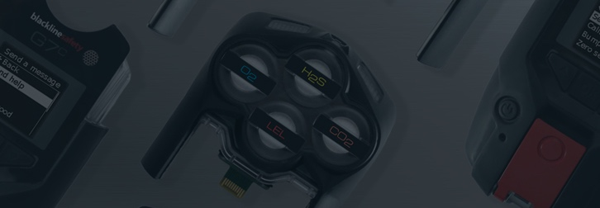
INTRODUCTION
WHO IS BLACKLINE SAFETY?
Headquartered in Calgary, Alberta, Canada
Global connected safety technology leader behind G7
Our talented team of designers and engineers create and manufacture everything in-house
In-house Safety Monitoring Center and Customer Care
We offer services in over 100 countries
Currently monitor over 25,000 employees around the world
We have recorded 26.5 million hours of equipment use and have managed over 850,000 customer alerts

Slide 3
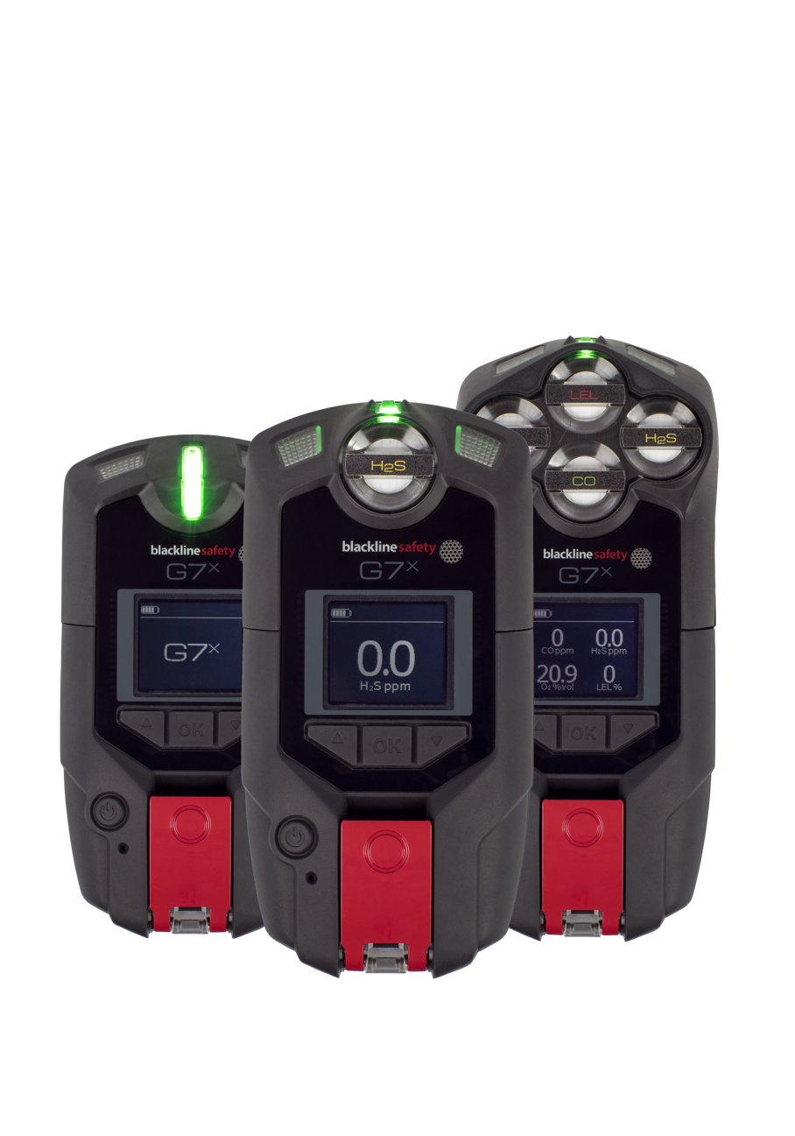
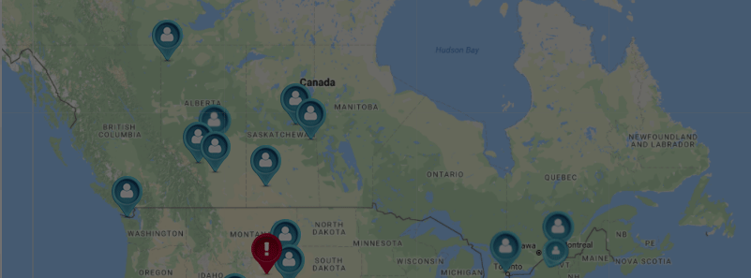
INTRODUCTION
Standard
Quad
WHAT IS G7?
Work-everywhere, wearable, personal safety monitor with gas detection
18 hours battery
2-way texting
Deliver instant situational awareness
Manage fastest response
Intrinsically Safe
Single
Notes:
What is G7?
G7 is the first true work-everywhere, wearable, personal safety monitor. It keeps you connected – whether it’s a gas leak, a health incident or an intruder.
Your G7 can trigger a facility evacuation, account for you on a real-time map. Should you require help, G7 delivers the instant situational awareness needed to manage the fastest possible response to make a difference.
G7 has your back at all times

Slide 4
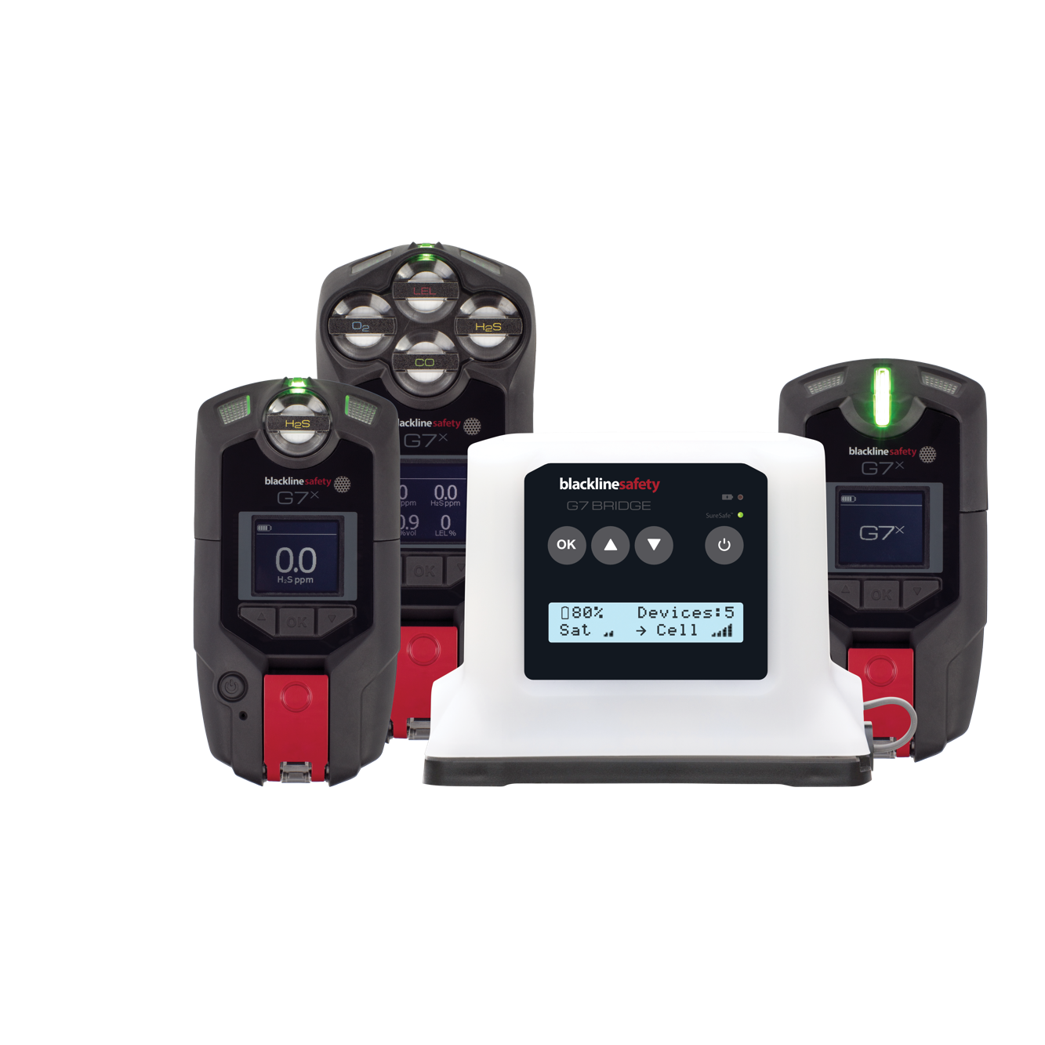
INTRODUCTION
WHAT IS BRIDGE?
Portable satellite & cellular base station
Works with G7x to monitor your safety even when out of cell range
Delivers mass notifications
Is capable of connecting to up to five G7x devices with a range of 2km
50 hours of battery -20 to 55C
Notes:
What is G7?
G7 is the first true work-everywhere, wearable, personal safety monitor. It keeps you connected – whether it’s a gas leak, a health incident or an intruder.
Your G7 can trigger a facility evacuation, account for you on a real-time map. Should you require help, G7 delivers the instant situational awareness needed to manage the fastest possible response to make a difference.
G7 has your back at all times

Slide 5

INTRODUCTION
SERVICE PLANS
Self-monitored
Your team monitors your Blackline Live account
Blackline Monitored
Blackline Safety’s in-house monitoring personnel monitor your team 24/7, 365 days a year
99.5% of alerts responded to in under 1 minute

Slide 6
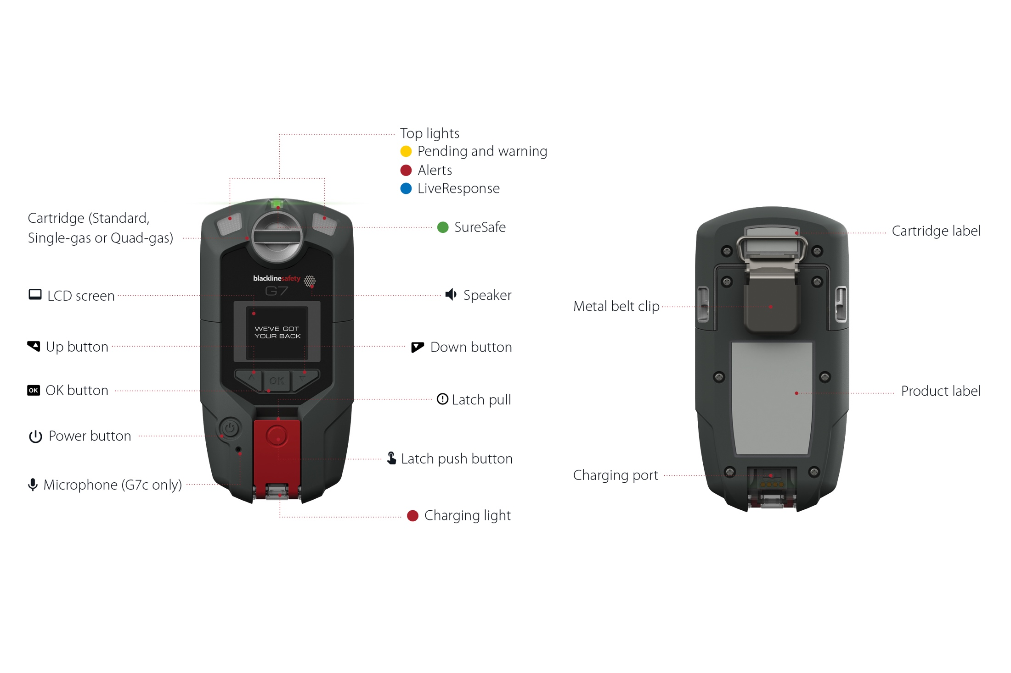
HARDWARE DETAILS – G7x
Notes:
Interacting with your G7 is easy with the high visibility LCD display and three button menu system.
OK BUTTON
Press OK to enter the main menu on the LCD screen, and confirm a menu selection.
UP AND DOWN ARROW BUTTONS
Press up or down to navigate the menu.
Press and hold both simultaneously to mute.
LATCH PULL
Pull down the latch to call for help when assistance is required.
LATCH PUSH BUTTON
Push the latch in to tell your G7 that you are safe.

Slide 7
HARDWARE DETAILS – G7 BRIDGE
Notes:
Interacting with your G7 is easy with the high visibility LCD display and three button menu system.
OK BUTTON
Press OK to enter the main menu on the LCD screen, and confirm a menu selection.
UP AND DOWN ARROW BUTTONS
Press up or down to navigate the menu.
LCD SCREEN
The LCD screen can be used to see menu options, battery life, how many G7x or 900 devices are connected and if G7 Bridge is connected to cellular or satellite communications.

Slide 8

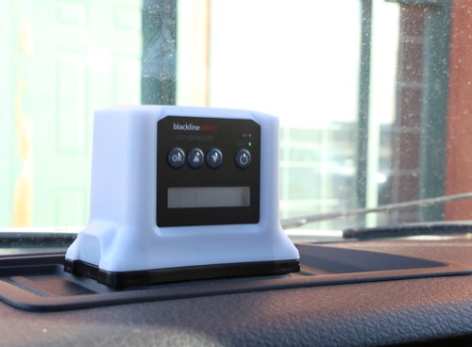
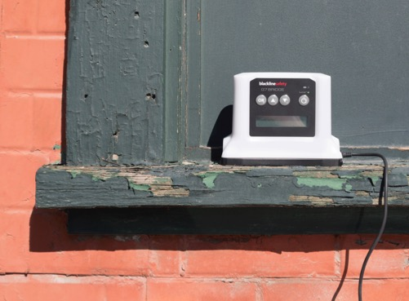
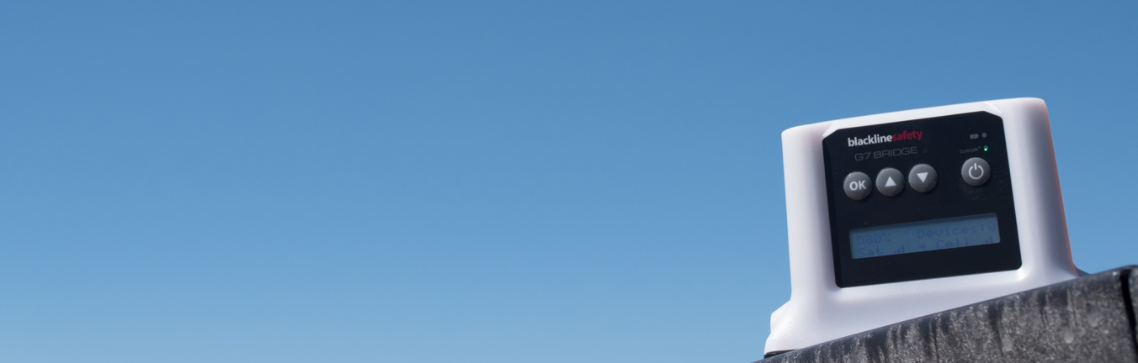
MOUNTING
Top of vehicle
Dash
On-site
ALWAYS MAKE SURE G7 BRIDGE HAS A CLEAR VIEW OF THE SKY, ESPECIALLY WHEN OUTSIDE CELL COVERAGE
Notes:
G7 Bridge can be mounted in a variety of places, including:
Top of vehicle
Dash
Back of vehicle
Truck boxes
Boats
ATVs
When operating G7 Bridge, ensure that it has a clear view of the sky, and is a minimum of 10 meters away from any buidings.

Slide 9
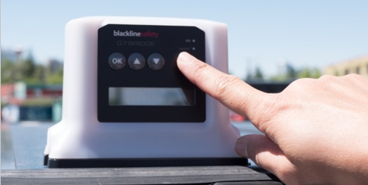
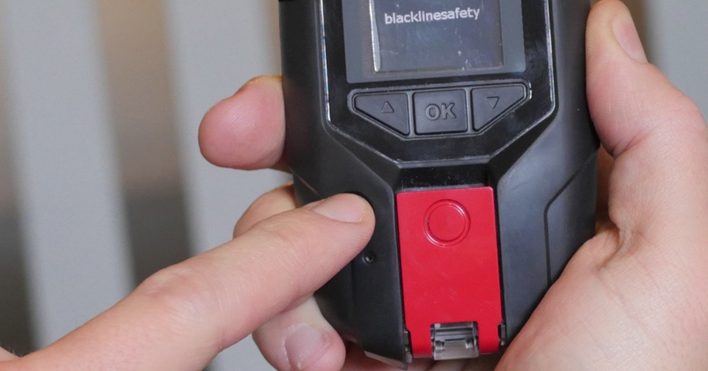
POWER ON
SURESAFE LIGHT
A blinking SureSafe Light means your device is trying to connect. Don’t panic! It’s OK to have a blinking light for small amounts of time.
A solid SureSafe Light means you are connected to the Blackline Safety Network.
Press the power button on G7 Bridge to turn the device on.
Press the power button once on G7x to turn the device on.
!
Always ensure that G7 Bridge is powered on before G7x.
Notes:
Power On
Ensure you are in a clean environment
Press the power button and wait for the blinking green SureSafe light to turn solid.
The device will cycle through all enabled features from your configuration.
Once connected, the green light will stay on and your safety is being monitored.
Going without coverage for small periods of time is OK! If you notice that your SureSafe light is blinking for periods longer than 45 minutes, you may want to consider alternative Blackline solutions.

Slide 10
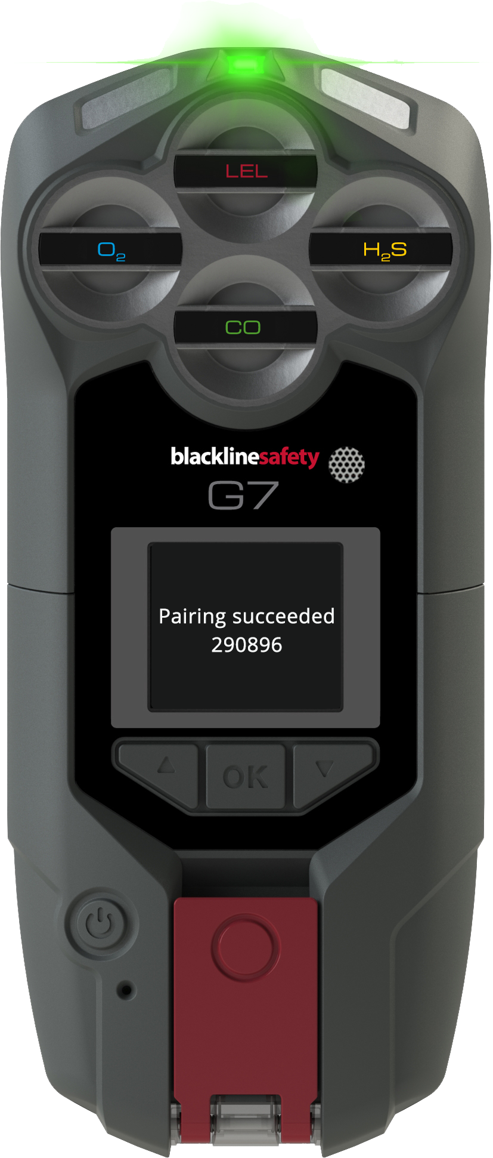
PAIRING G7X
Pairing new G7x devices is a one-time setup step. After being paired, G7x and any G7 Bridge in your organization will automatically connect to one another when on and in range.
G7x will let you know it needs to be paired by sounding a yellow warning alarm and by showing pairing needed in the banner. To pair:
Turn on G7 Bridge
Press OK on G7 Bridge to open Bridge’s menu
Use the up and down arrows to navigate to pair new loners
and press OK
Use the up and down arrows to navigate to start and press OK
G7 Bridge’s screen will say pairing started as it looks for devices
Turn on up to 5 G7x devices
When G7x has been paired, you will notice the following:
  G7 Bridge’s main screen will show that it has connected devices
  The yellow warning alarm on G7x will silence
  G7x’s green connectivity light will be solid (not flashing)
  You will receive a message on G7’s screen that reads pairing succeeded and shows your organization’s Bridge network key
Press OK on G7 Bridge to stop pairing once all necessary devices have been paired
Notes:
G7x will let you know it needs to be paired by sounding a yellow warning alarm and by showing pairing needed in the banner. To pair:
Turn on G7 Bridge
Press OK on G7 Bridge to open Bridge’s menu
Use the up and down arrows to navigate to pair new loners and press OK
Use the up and down arrows to navigate to start and press OK
NOTE: if your G7 Bridge will not allow you to start pairing, this means it has not yet been assigned a network key for your organization. Please contact our Customer Care team.
G7 Bridge’s screen will say pairing started as it looks for devices
Turn on up to 5 G7x devices
NOTE: G7 Bridge can only connect to 5 G7x devices at once.
When G7x has been paired, you will notice the following:
G7 Bridge’s main screen will show that it has connected devices
The yellow warning alarm on G7x will silence
G7x’s green connectivity light will be solid (not flashing)
You will receive a message on G7’s screen that reads pairing succeeded and shows your organization’s Bridge network key
Press OK on G7 Bridge to stop pairing once all necessary devices have been paired

Slide 11
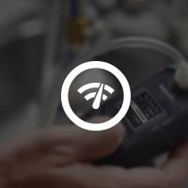
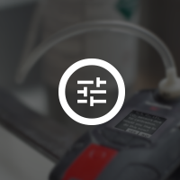
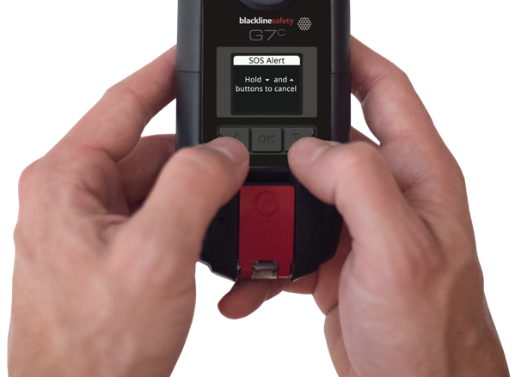

BUMP TEST / CALIBRATION
Bump Test
Calibration
G7 will let you know it’s time to bump or calibrate upon start up.
What do I do?
Press and hold
the up and down arrows
to silence this reminder.
Then, bump or calibrate using one of the methods on the next slide.
Notes:
When you turn your device on, it will inform you with a yellow warning alarm if a bump test or calibration is due. Read G7’s screen to see what is due and then press and hold the up and down arrows to silence this alarm.

Slide 12
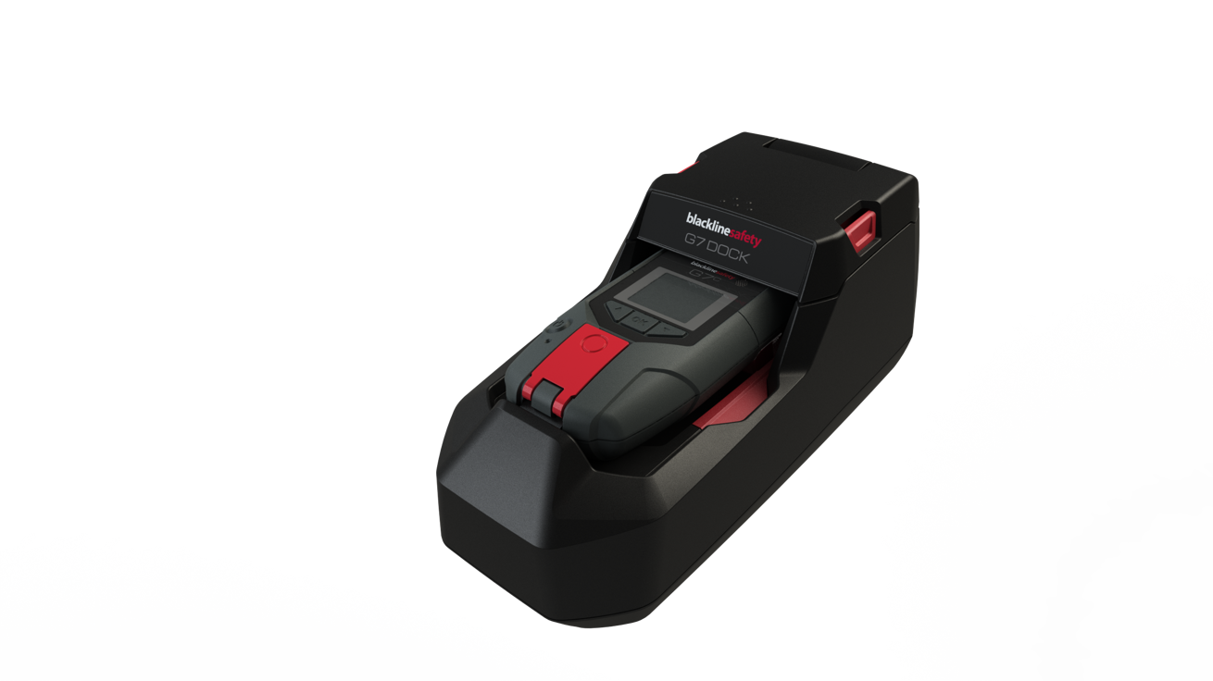
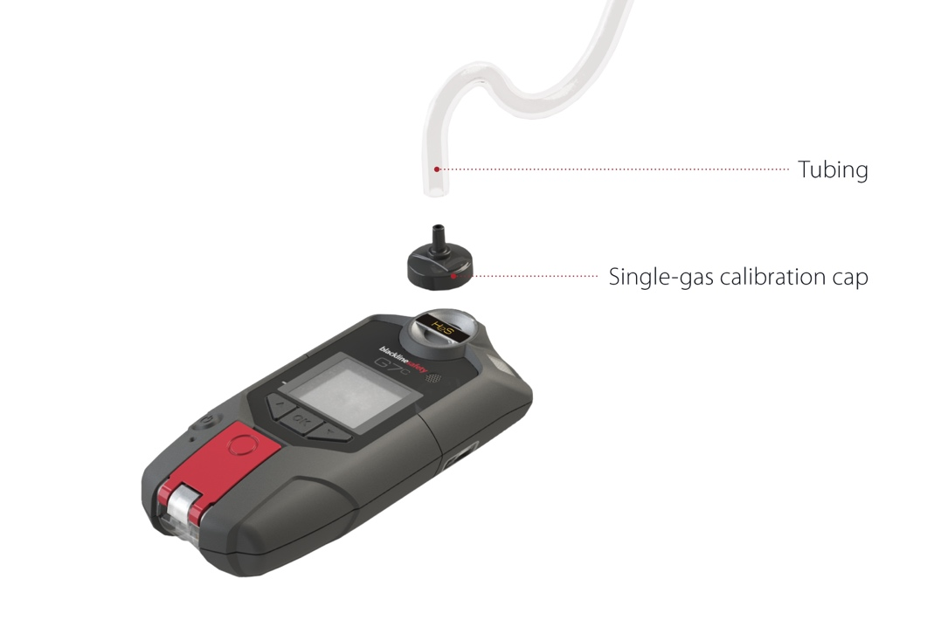
BUMP TEST / CALIBRATION
You can bump and calibrate in one of two ways:
With G7 Dock:
Place G7 in dock
Close the lid
Select bump test/calibration from the menu
Let G7 Dock do its thing!
Manually:
Press OK to access the menu
Use the up and down arrows to navigate to bump test
Select bump test
Follow the steps on screen
Notes:
Included with your G7 is a calibration cap and tubing to perform bump test and to calibration your device. Only perform bump test and calibrations in a safe environment.
You can perform a bump test or calibration by selecting it from the main menu.
You can also perform bump tests and calibration with G7 dock.
Bump Test
It is safe practice to regularly test the alarm indicators (light, sound and vibration) by applying enough gas to confirm the sensors will trigger an alarm when gas is detected.
It is recommended that you perform a bump test at the start of your shift, or as often as required in your company’s safety policy.
Calibration
Gas sensors periodically need to be calibrated by applying a known concentration of gas for a set period of time. This procedure ensures the sensor is accurately detecting gas levels throughout its life cycle.
The interval of how often the sensors require calibration is dependent on your company’s safety protocol, and Blackline recommends not exceeding 180 days without a calibration.

Slide 13
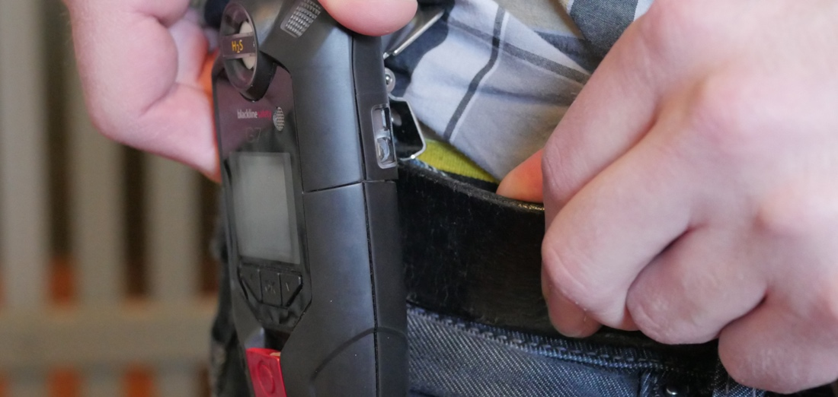
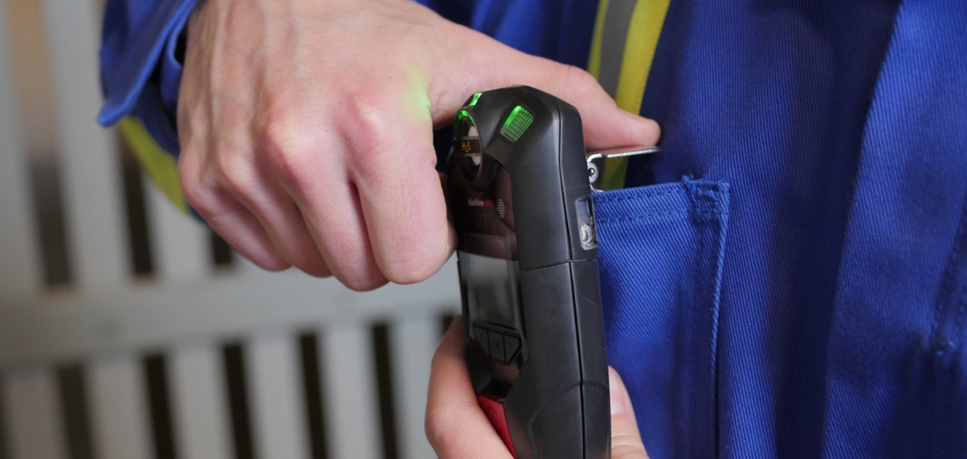
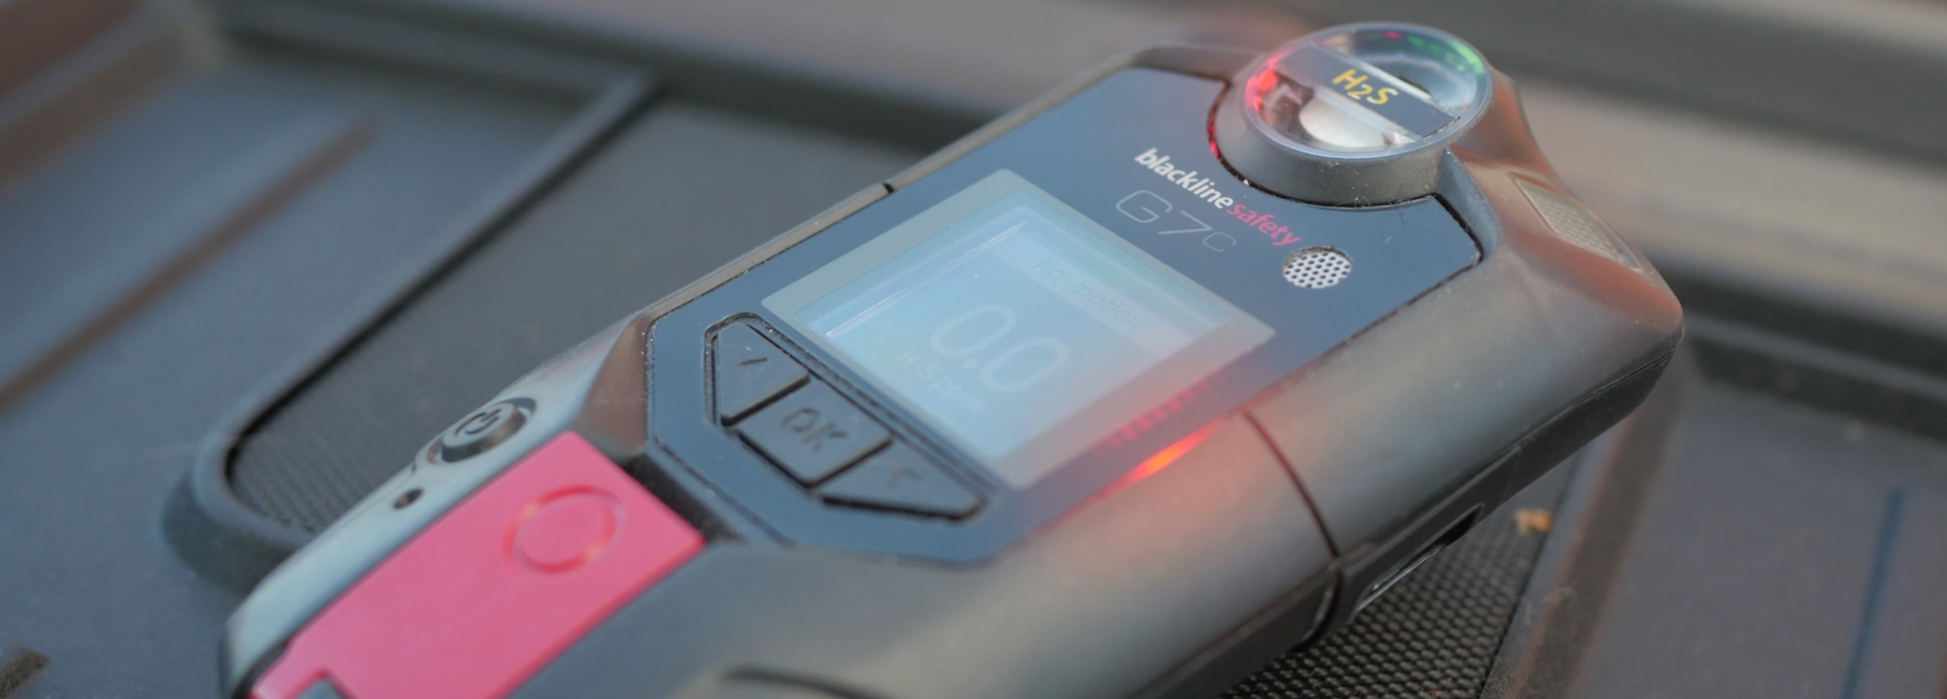
WEARING
Belt
Chest
DO NOT LEAVE G7 UNATTENDED WHEN POWERED ON, THIS CAN LEAD TO FALSE RED ALERTS
Notes:
G7 monitors you best when clipped to your belt or chest pocket.
Do not leave your G7 unattended when powered on, this can lead to false red alerts.

Slide 14
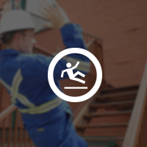
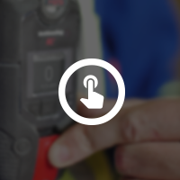
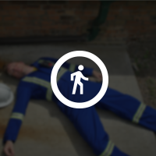
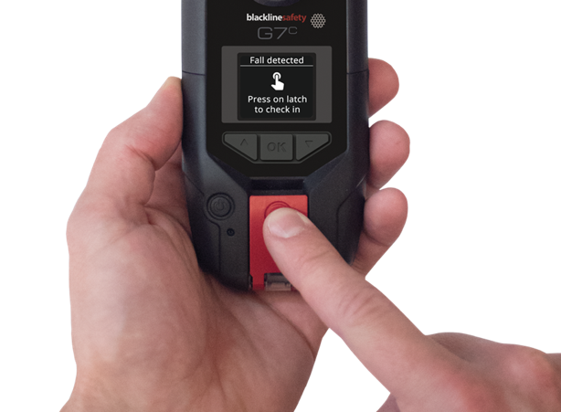
YELLOW PENDING ALARM
YELLOW PENDING ALARM
Fall detection
Check-in timer
No-motion
What do I do?
Are you OK?
If yes, press the latch
to return the device to normal function.
Notes:
Your device is constantly monitoring you for falls, if you stop moving and is equipped with a check-in timer.. If a potential fall, no-motion or missed check-in is detected, your G7 will go into a yellow pending alarm.
Your device wants to know if you are safe.
If you are safe, push the red latch button.

Slide 15
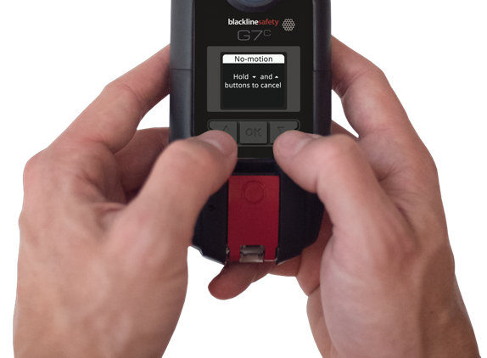
YELLOW PENDING ALARM
What happens if you don’t tell the device you’re OK?
YELLOW PENDING ALARM
RED ALERT
If you don’t confirm you’re OK, the Yellow Pending Alarm escalates into Red Alert and notifies monitoring personnel.
What do I do?
Press and hold the up and down arrows to mute the device.
Remember – this doesn’t cancel the alert.
Notes:
If you do not push the red latch button within the configured amount of time, your yellow pending alarm will escalate into a red alert.
Red alerts are immediately communicated to monitoring personnel.
Read the information on your G7 screen. Press and hold the up and down buttons at the same time to mute the sound and vibration. This does not cancel the red alert sent to monitoring personnel.

Slide 16

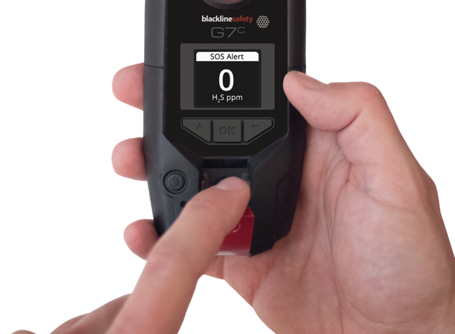

SOS ALERT
If you need to request help right away, you can trigger a SOS Alert.
What do I do?
Pull the latch!
How do I silence the alarm?
Press and hold the up and down arrows. Remember – this does not cancel the alert.
Notes:
If you require assistance, you can manually send an SOS alert to monitoring personnel requesting immediate help to your location by pulling the red latch.
Red alerts are immediately communicated to monitoring personnel.
Read the information on your G7 screen. Press and hold the up and down buttons at the same time to mute the sound and vibration. This does not cancel the red alert sent to monitoring personnel.

Slide 17
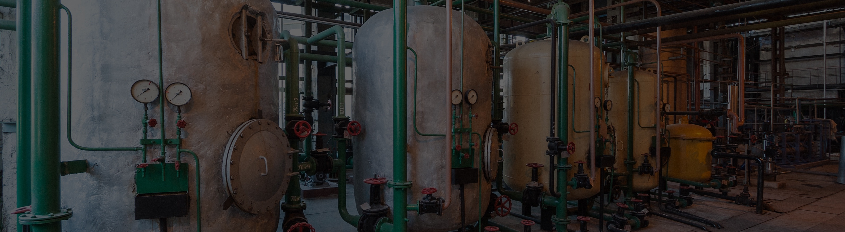


RED GAS ALERT
STEL
(SHORT TERM EXPOSURE LIMIT)
TWA
(TIME WEIGHTED AVERAGE)
HIGH
ALERT
OL
(OVER LIMIT)
G7 is informing you of something dangerous in your environment.
For real-time customers, certain gas alerts will automatically generate a red alert and notify monitoring personnel.
What do I do?
Evacuate the area. When it is safe to do so, press and hold the up and down arrows to mute G7’s lights and sounds.
Notes:
Evacuate the area, and when it is safe to do so read the information on your G7 screen. Press and hold the up and down buttons at the same time to mute the sound and vibration. Certain gas alerts trigger a red alert with monitoring personnel for real-time customers, pressing and holding the up and down arrows does not cancel the red alert sent to monitoring personnel.

Slide 18
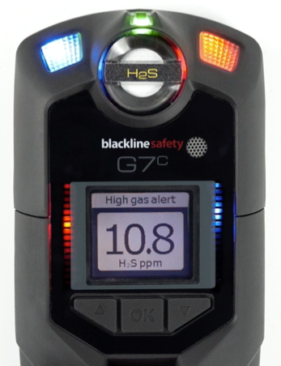
LIVE RESPONSE
LIVERESPONSE
The LiveResponse light will flash blue when monitoring personnel respond to your Alert using your company’s alert response protocol. When it shines on your device, it means someone will be contacting you to confirm you are OK.
What do I do?
Nothing! Wait for monitoring personnel
to call or message you,
and then let them know
if you’re OK or if you need help.
?
Who are monitoring personnel?
Personnel are the Blackline Live Safety Agents or your own monitoring team.
Notes:
The blue LiveResponse light will blink when monitoring personnel have acknowledge your red alert.
G7 will automatically connect your speaker phone to monitoring personnel, you will hear a beep signifying a two-way call has been connected. Monitoring personnel may also ask if you are OK via text message.
Once monitoring personnel have resolved the red alert, the blue LiveResponse light will shut off.

Slide 19
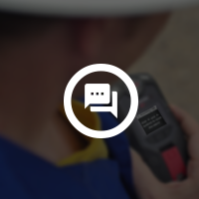
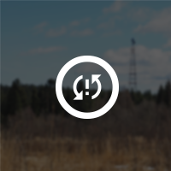
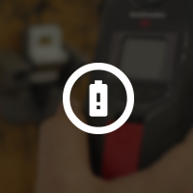

YELLOW WARNING ALARM
YELLOW WARNING ALARM
New message
Network
Connection
Interruption
Low battery
Bump Test
Calibration
Low warning alarm for gas
Sensor error
Under limit
What do I do?
After you’ve read the screen, press and hold the up and down arrows to silence the device
Remember – Yellow warning alarms never escalate to Red Alerts. They are always between you and your device.
Notes:
Yellow warning alarms are communication between you and the device only, they never escalate to red alerts. G7 has something to tell you, read the screen and then press the up ad down arrows to silence.

Slide 20
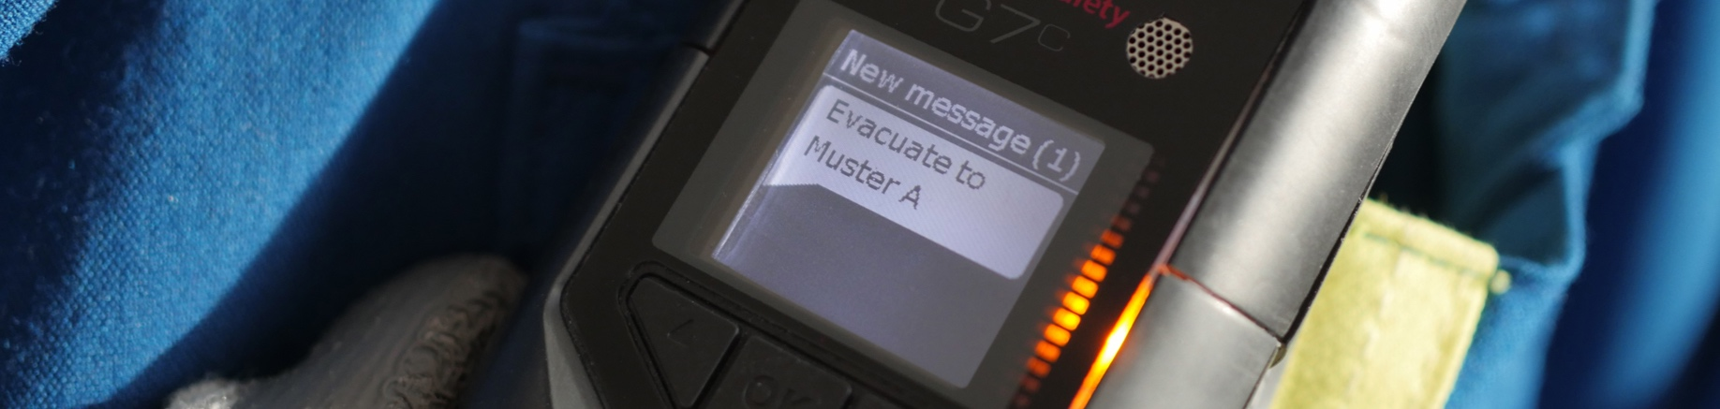


MESSAGING
SENDING
RECEIVING
Sending a message:
Press OK
Select send message
Scroll to the message you want to send, press OK.
Receiving a message:
Read your message
Press and hold the up and down arrows for 3 seconds
Notes:
In an emergency situation your device can receive and send messages to monitoring personnel.
Receiving a message
When there is an incoming message, your G7 will inform you with a yellow warning alarm.
Your screen will let you know how many unread messages you have and collects them in your inbox which can be accessed through the menu.
Sending a message
You can choose from a list of 10 pre-programmed messages to send to monitoring personnel.
Press OK button to enter the main menu, the up or down arrow to navigate the menu, highlight your selection and press OK to send.
Custom messages
At the bottom of the pre-programmed message list is an option to send a custom message.
You can create a 16-character custom message to send to monitoring personnel by using the up or down arrow buttons to scroll through the alphabet.
Press the OK button to move to the next character.
Press OK to send the message.

Slide 21

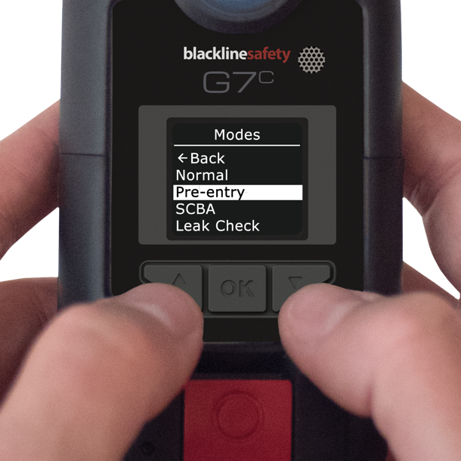
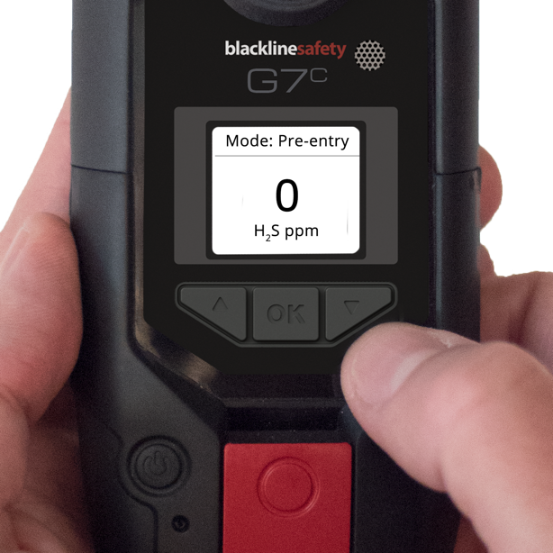
CONFIGURATION MODES
Available Modes
ENTERING A MODE
What is seen on your device is dependent on your configuration profile in Blackline Live
Normal mode
G7’s default for everyday operation
Pre entry
For checking an atmosphere before entering, with or without pump.
SCBA
For use with a supplied-air or self-contained breathing apparatus
Leak check
For checking an area for leaks,
with or without pump.
High risk
For general high risk situations,
like evacuations.
Pump run
Runs the pump continuously – such as for use in a hole-watch situation. A pump is required for this mode.
Entering a mode can be done from G7’s main or secondary menu.
When a mode is entered, G7’s screen will invert and the mode will be displayed in the top information banner.
Notes:
In an emergency situation your device can receive and send messages to monitoring personnel.
Available modes
Normal operation
Configuration for everyday operation. G7’s default mode.
Pre entry
Used before entering a space that could potentially contain dangerous gas. Can be used with or without pump.
SCBA
Used when the device user is wearing a self-contained or supplied air breathing apparatus and is entering an area that is known to have high gas levels.
Leak check
Used when checking for gas leaks in a particular area. Can be used with or without pump
High risk
Meant for general high-risk situations, such as an evacuation or travelling through a dangerous area. Unlike the other modes, you will never be timed out and must exit it manually.
Entering a mode
To enter a mode from the modes menu:
Press OK to enter G7’s main menu
Use the up and down arrows to navigate to modes
Press OK to enter the modes menu
Select the mode you wish to enter
Confirm that you want to enter the mode by selecting yes
G7’s screen will invert and your information banner will display your current mode
To enter a mode from the main status screen:
Press the up or down arrow to open G7’s secondary menu
Continue to press the up or down arrow until you reach your desired mode
Press OK to enter the mode
G7’s screen will invert and your information banner will display your current mode

Slide 22
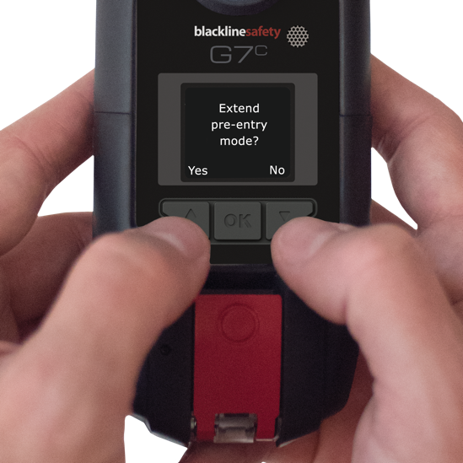
CONFIGURATION MODES
EXTENDING A MODE
When a mode timeout is reached, G7 will confirm that you’d like to stay in this mode.
What do I do?
Press the up arrow to extend the mode. Press the down arrow to exit the mode.
If you do not confirm that you would like to extend your mode within 30 seconds,
G7 will return to normal mode, and if check-in is enabled, ask you to check in.
NOTE: High risk and pump run modes do not have a timeout, you must manually return to normal mode.
Notes:
Pre-entry, Leak Check and SCBA mode have configurable timeout periods. When this period expires, G7 will ask you if you’d like to stay in the mode. Read the screen, and press the up arrow to extend the mode for another period or the down arrow to exit the mode and return to normal device function.
If you do not make a choice within 30 seconds, G7 will automatically return to normal mode. If you have the check-in timer enabled, it will immediately prompt a check in to ensure that you are OK.

Slide 23
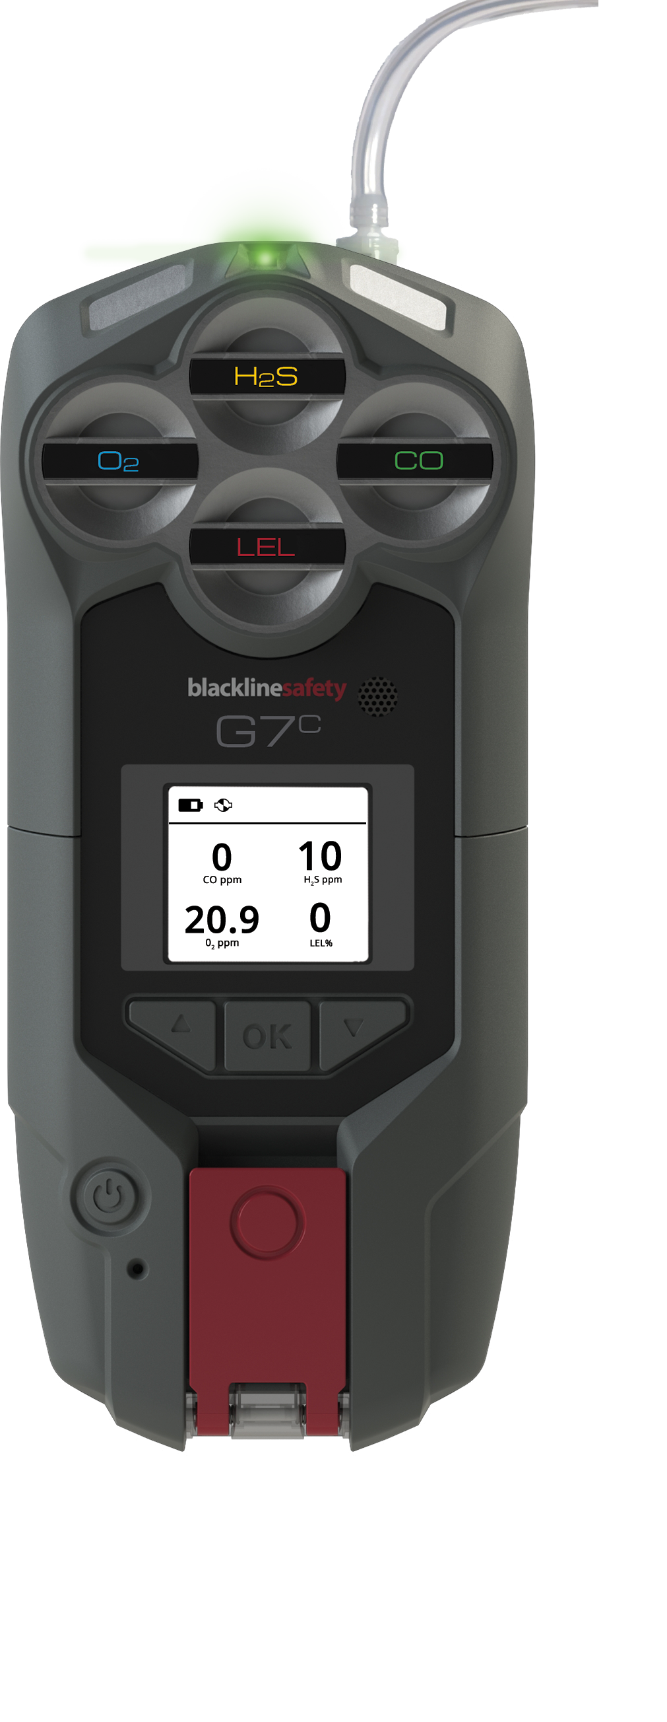
G7 MULTI-PUMP CARTRIDGE
Tubing
Quick-connect
Pump
TURNING PUMP ON
Attach a multi-gas pump cartridge to G7
Enter a pumped mode, such as pre-entry or leak check
Perform a block test, following the steps on G7’s screen.
Pump will start automatically
NOTE: if the block test fails, the device will not enter the mode and pump won’t start.
TURNING PUMP OFF
Enter a non-pumped mode, such as normal, SCBA or high-risk.
Notes:
A pump cartridge is used to sample air from areas to test if they are safe before entering.

Slide 24
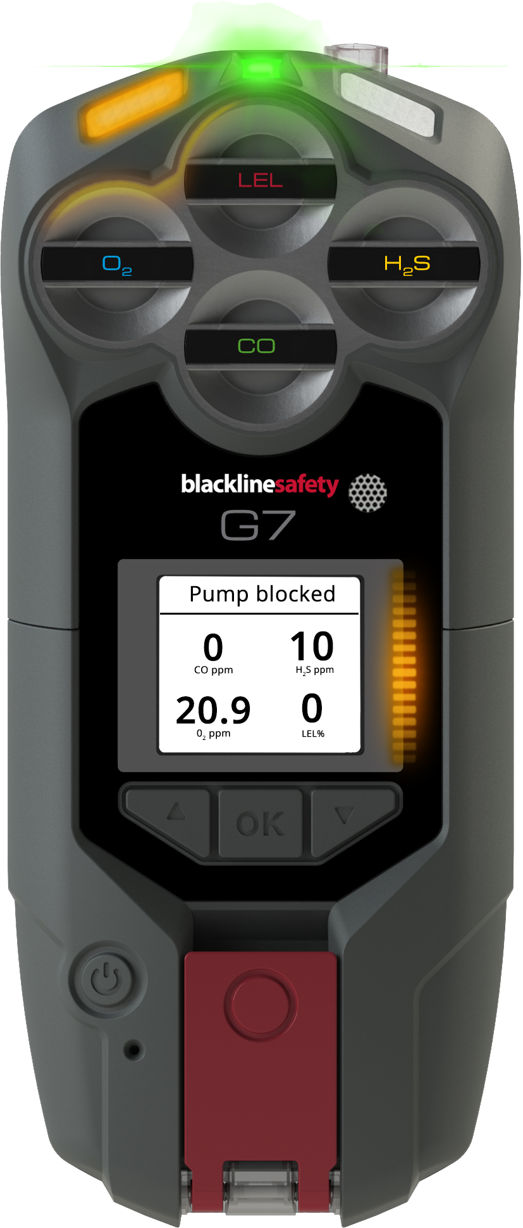
BLOCK TESTS
Block tests are performed to ensure your equipment is working properly before using pump to test the gas levels in an environment.
Blackline’s G7 multi-pump cartridge has two types of block tests:
AUTOMATIC BLOCK TEST
MANUAL BLOCK TEST
This is the block test that you can perform anytime a pump is running.
To perform a manual block test:
Plug the end of your inlet
Wait for a yellow warning alarm
Unplug the end of your inlet
Wait for the alarm to stop
If the yellow warning alarm sounds when you plug, and stops when you release – your equipment is safe to use.
This is the block test that G7 runs through before entering a pumped mode.
The instructions for this block test appear on G7’s screen. If you pass the block test, G7 will enter the mode and pump will turn on.
If you fail the block test, G7 will return to normal mode.
NOTE: G7 will go into yellow warning alarm when the pump is blocked during use.
Notes:
Block tests are performed to ensure your equipment is working properly before using pump to test the gas levels in an environment. This ensures you don’t have holes or kinks in your tubing.
G7 has two types of block tests, automatic and manual. The automatic block test runs any time you try to enter a pumped mode with a pump cartridge attached. G7 will tell you the steps on the screen. If you pass, you will enter the pump mode and pump will start automatically. If you fail, G7 will return to normal mode.
A manual block test can be performed any time a pump is running. To do so, you attach a quick connect with tubing, plug your inlet and wait for a yellow warning. Once the yellow warning sounds, you can unplug your inlet and wait for it to stop. If the yellow warning stops, your equipment is safe to use.

Slide 25

PUMP MENU OPTIONS
When a G7 multi-pump cartridge is attached, a new secondary menu and main menu option appear.
Pump options
Back
Sample time ON
Hose length
PUMP OPTIONS MENU
The pump options menu is available from G7’s main menu, under settings.
This is where you will set things such as:
Enabling/disabling sample timer
Hose length
SECONDARY MENU
Pump on
Hose L: 10m
300 ml/min
Sample 70 sec.
The pump secondary menu is available by pressing
the down arrow button from G7’s main screen.
Here you will see things such as:
If the pump is on/off
Hose length (set from the pump options menu)
Flow rate (in real time, maintained by G7)
Sample timer (if enabled from pump options)

Slide 26
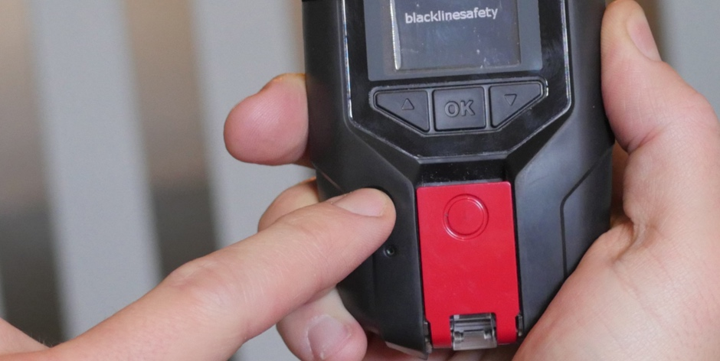
POWER OFF
Press and hold G7x’s power button for 3 seconds to turn the device off.
Press and hold G7 Bridge’s power button for 3 seconds to power off.
!
Always ensure that all connected G7x’s have been powered off before G7 Bridge.
Before powering down, ensure you have a solid SureSafe light.
When all lights have stopped flashing, your device has been fully powered down and your safety is no longer being monitored.
Notes:
Power Off
Before powering off, ensure that you have a solid green SureSafe light. When you do, press and hold the power button.
The device will go into shutdown sequence, it could take a few minutes to log off from the network
Once all the lights and vibrations have stopped you have been logged off from the Blackline Safety Network and your safety is no longer being monitored.
Always ensure that all connected G7x have been completely powered down before turning of G7 Bridge.

Slide 27
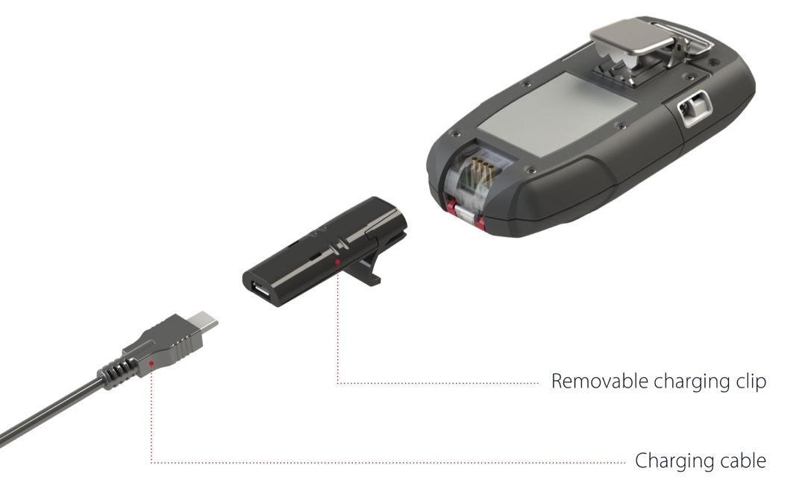
CHARGING
G7x has an 18 hour battery life
Remember to charge after every shift!
What do I do?
Put the clip into the base of the G7, then plug in the micro USB.
Notes:
Insert the micro USB plug into the removable charging clip, then slide the clip onto the charging port at the bottom of your G7.
A solid red light at the bottom of the device indicates your G7 is charging.
The LCD screen will let you know when the device is fully charged.
Blackline recommends that you fully charge your device after every shift.
Charging will automatically turn off your G7 off to ensure it will not trigger alerts while in the charging process.

Slide 28
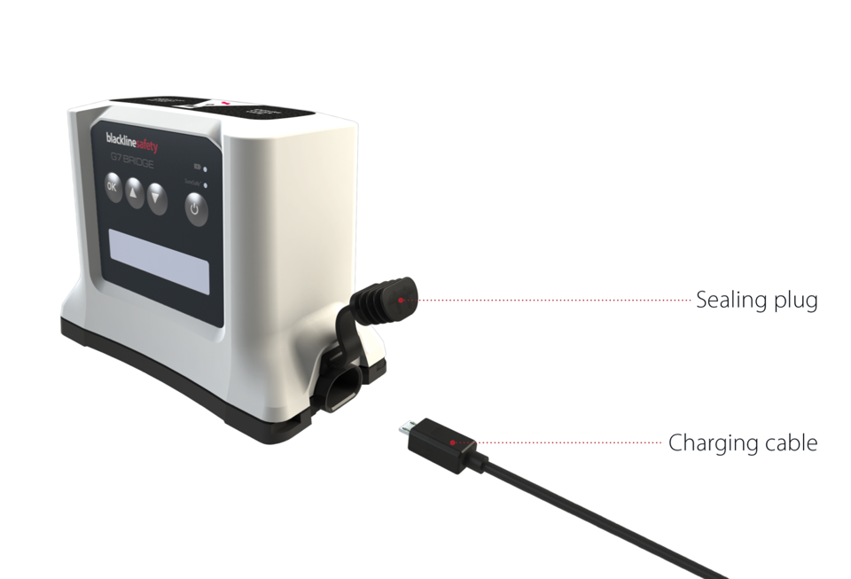
CHARGING
G7 Bridge has a 50 hour battery life
Remember to charge after every shift!
What do I do?
Put the clip into the side of G7 Bridge then plug in the micro USB.
Notes:
Insert the micro USB plug into the removable charging clip, then slide the clip onto the charging port on the side of G7 Bridge.
A solid red light at the bottom of the device indicates your G7 is charging.
The LCD screen will let you know when the device is fully charged.
Blackline recommends that you fully charge your device after every shift.
Charging will automatically turn off your G7 off to ensure it will not trigger alerts while in the charging process.

Slide 30

SUPPORT
support.BlacklineSafety.com
CUSTOMER CARE
For technical support, please contact our Customer Care team.
North America (24 hours)
Toll Free: 1-877-869-7212
support@blacklinesafety.com
International (24 hours)
+1-403-452-0327
support@blacklinesafety.com

