Slide 1

BLACKLINE LIVE
live.blacklinesafety.com

Slide 2

INTRODUCTION
WHAT IS BLACKLINE LIVE?
Cloud-hosted web portal
Visibility on all your workers and keeping your contact information up to date
This is where you will find your main dashboard with associated devices, a live map, account settings, and configuration profiles.
Notes:
Blackline Live is a cloud-hosted web portal used to monitor and manage all your workers and devices.
With Blackline Live’s real-time alerting and live map, you can quickly locate and respond to a worker in distress. Real-time alerts show the device location on the map with the type of alert, enabling your team to efficiently send the help they need.
Blackline Live also allows you to create and customize configuration profiles that determine how a device or a group of devices operate in the field. Similarly, alert profiles are set up to determine what contacts should be notified in the event of an incident and what response protocol monitoring personnel will follow to ensure your team gets the help it needs.
Blackline Live keeps track o your alert history, reports, calibration and bump tests, eliminating the need for manual gas and incident logs.
G7 is capable of receiving text messages from Blackline Live, with the option of receiving voice communications.

Slide 3
SUMMARY
It is your responsibility to make sure the following are up to date:
Contacts
Device users
Assigned devices
Emergency response protocols

Slide 4
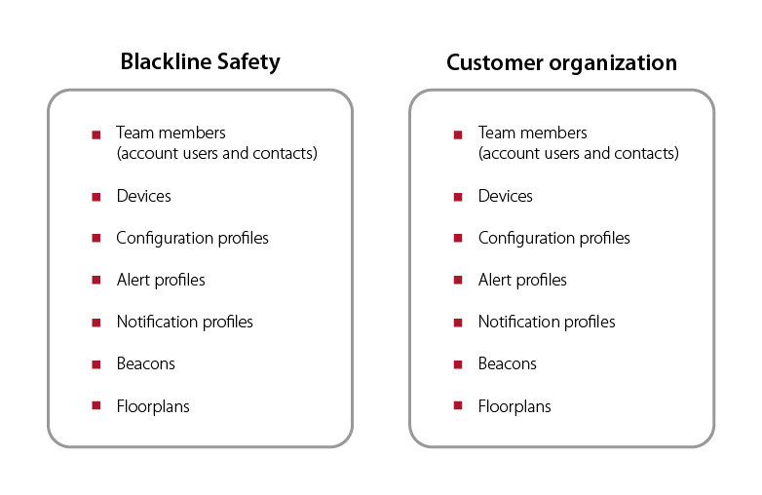
ORGANIZATIONS
Notes:
Organizations house a company’s Blackline resources
Devices
Team members
Configuration profiles
Alert profiles
Beacons
Floorplans
Employees of the company can log in using their own credentials, but will be a part of the organization and will have access to the same pool of resources.
Can be connected to other organizations using relationships.

Slide 5
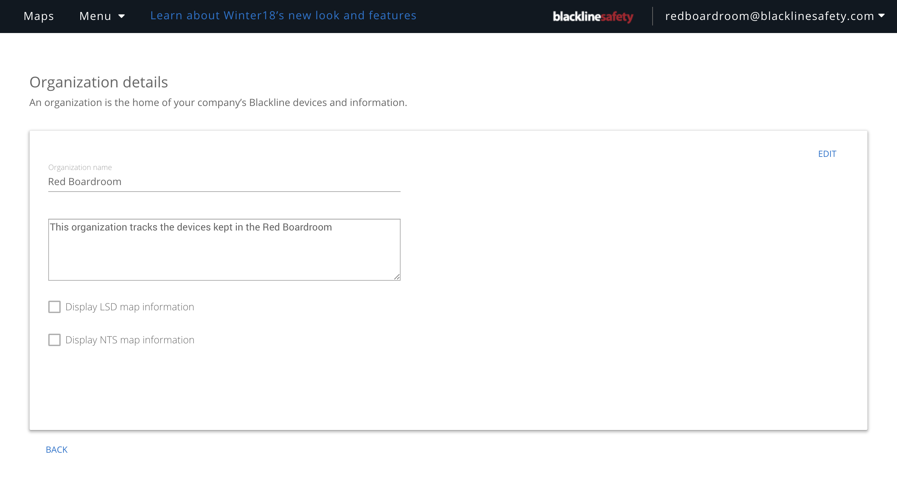
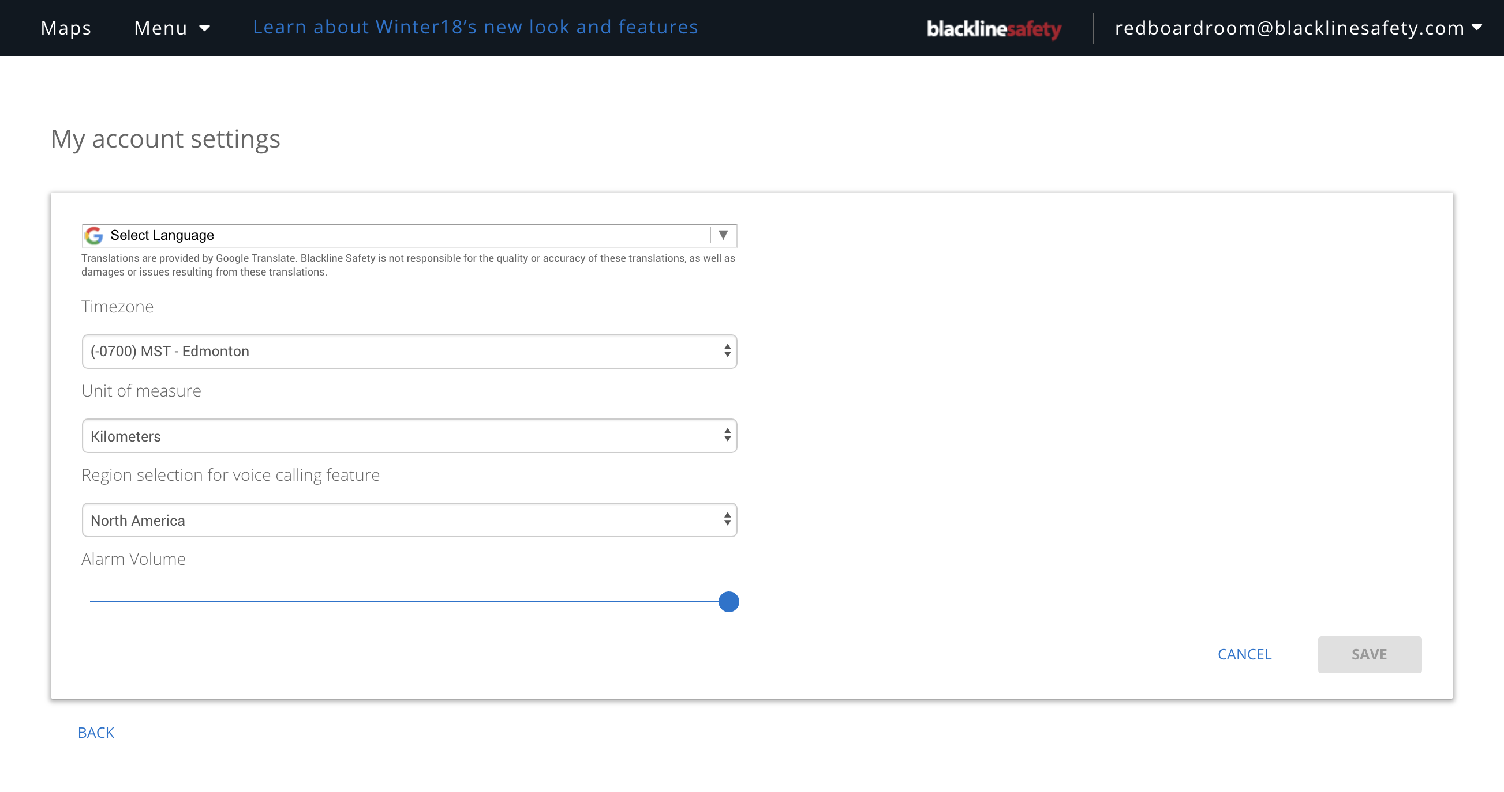
ORGANIZATION DETALS & ACCOUNT SETTINGS
Organization details
Information about the organization
Can be seen by all in an organization
Can be edited only by the organization admin
Account settings
Information about how you view the portal
Can only be seen and edited by you
Notes:
Organization details
Identifying info about organization
Can be seen by all account users within an organization
Can only be edited by the org admin
Account settings
How you view the portal
Can only be seen and accessed by you
Personal contact information has been moved to a different page

Slide 6
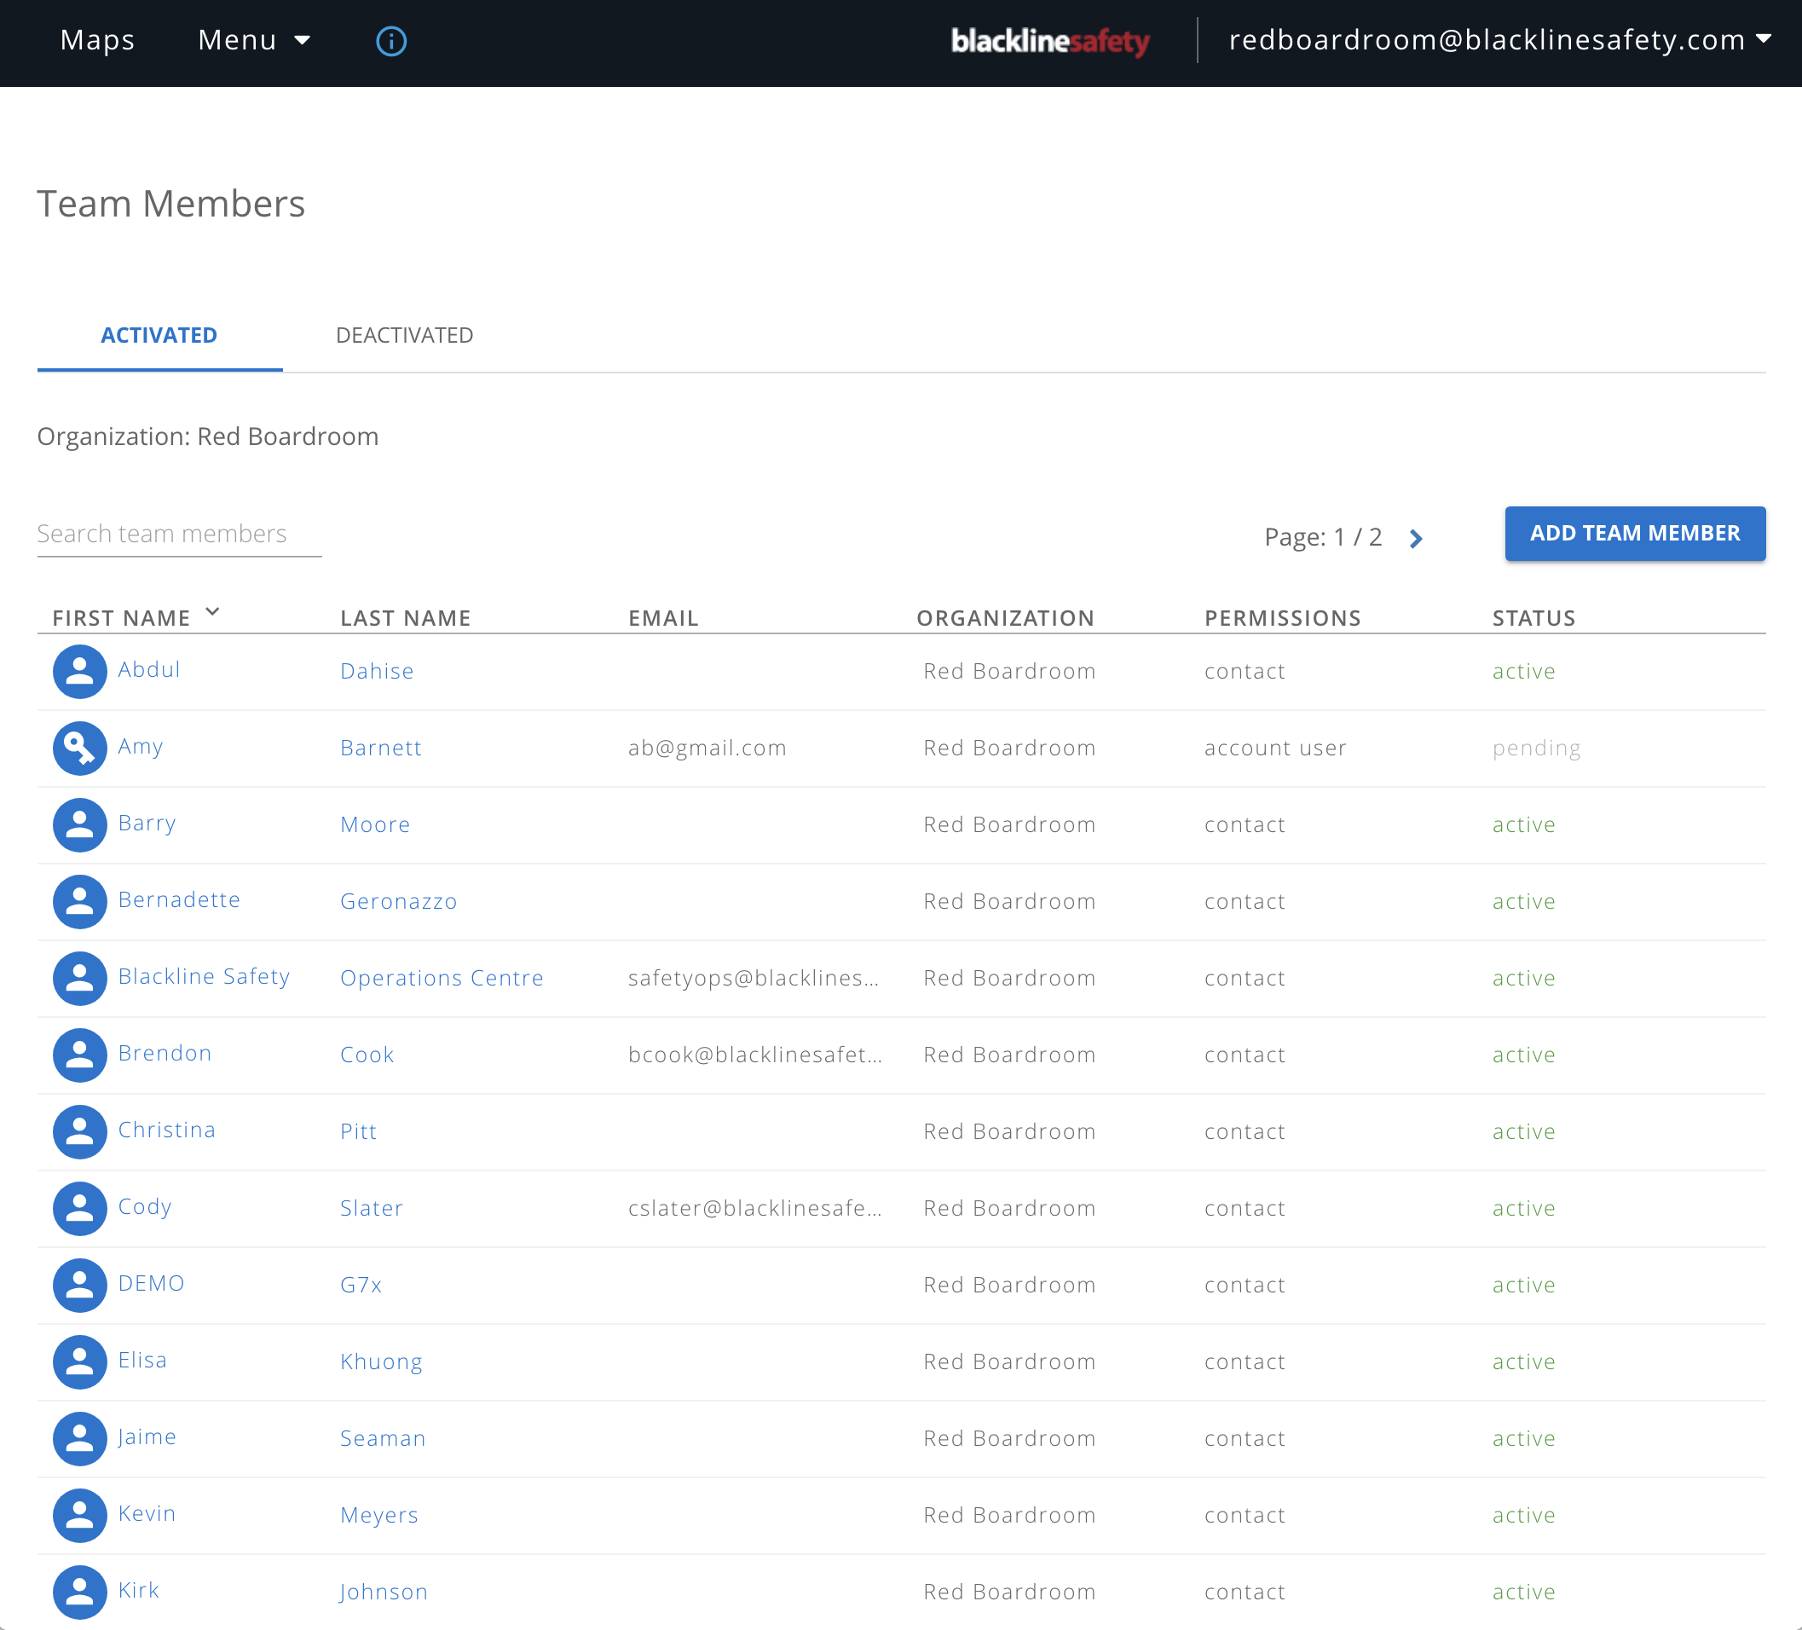
TEAM MEMBERS
Notes:
Team members page
Lists the people in your organization
Can be sorted and searched
Names can be clicked for additional information

Slide 7


TEAM MEMBERS
CONTACT
ACCOUNT USER
Do not have
log-in access
Can be assigned to devices and profiles
Do have log-in access
Can be assigned to devices and profiles
Notes:
Both can be assigned to alert profiles
Both can be assigned to devices
Contacts do NOT have log-in access
Account users do

Slide 8
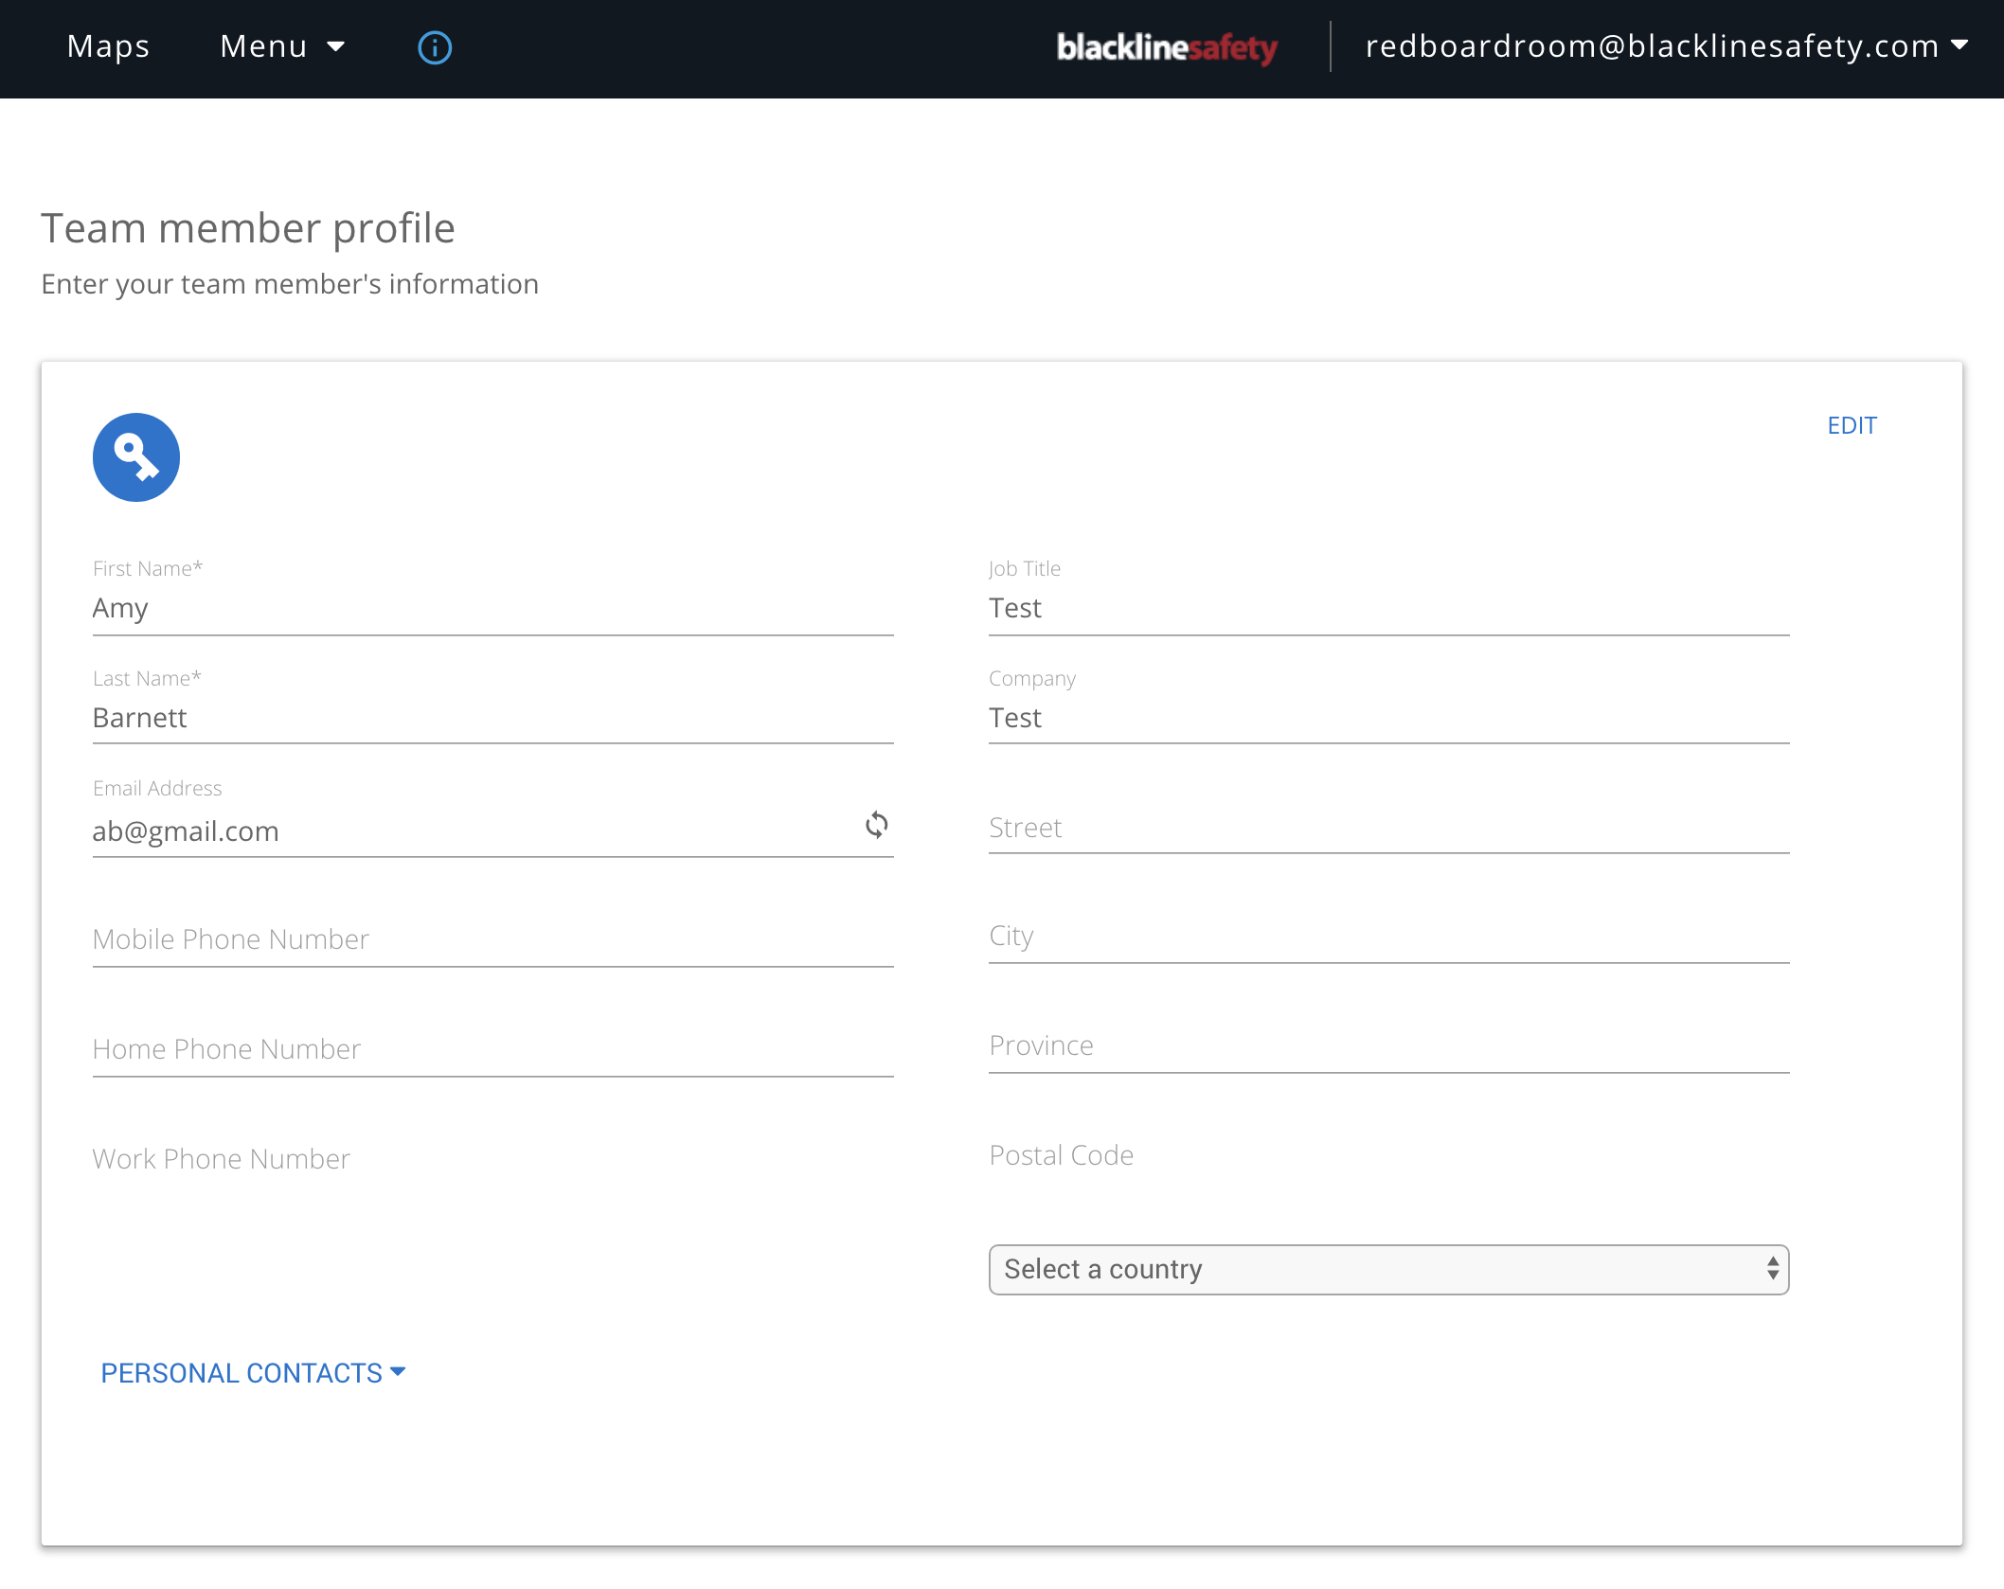
TEAM MEMBERS
*If the profile fails to save, make sure there are no extra spaces in any of the text fields
Notes:
*If you cannot save, check to make sure there are no extra spaces at the beginning or end of any fields*
Team member profile
Where a team member’s contact information is kept.
Account user’s roles in the portal can be managed on this page
Keep this information up to date

Slide 9
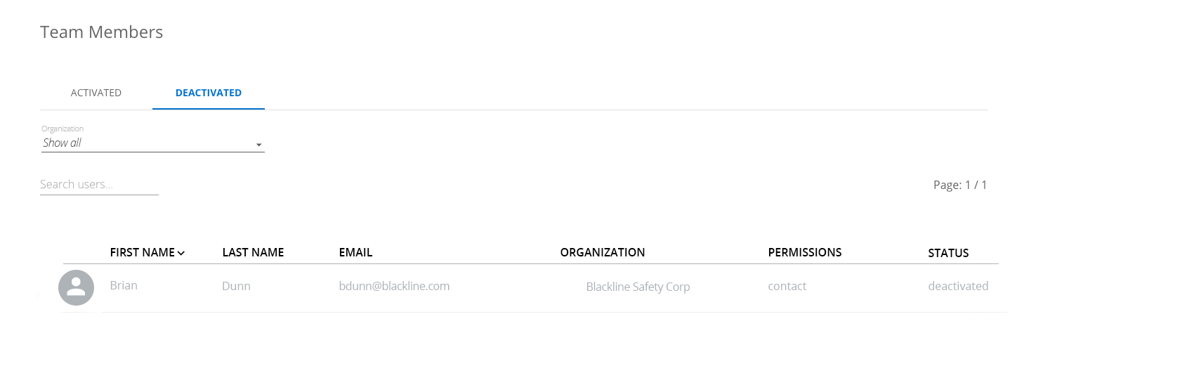
TEAM MEMBERS
Invitation Status
Pending – the portal invitation has been sent, but there has been no response.
Active – the portal invitation has been opened, and the email has been
confirmed to be active.
*Only applies to account users — all contacts default with active status
Deactivated team members
Notes:
Invitation status
When creating an account user, they will need to log into their email and accept an invitation to the portal.
“Pending” status indicates they have been sent the invitation but haven’t accepted it
“Active” indicates that they have accepted the invitation and are active in the portal
Deactivated team members
Team members can be deactivated if they leave the company
Seen on the team members page by clicking on the “deactivated” tab
Deactivating unassigns them from devices and removes them from alert profiles
Cannot be edited or assigned while deactivated
Can be reactivated – reactivation will not reassign them to their previous device or put them back into alert profiles

Slide 10
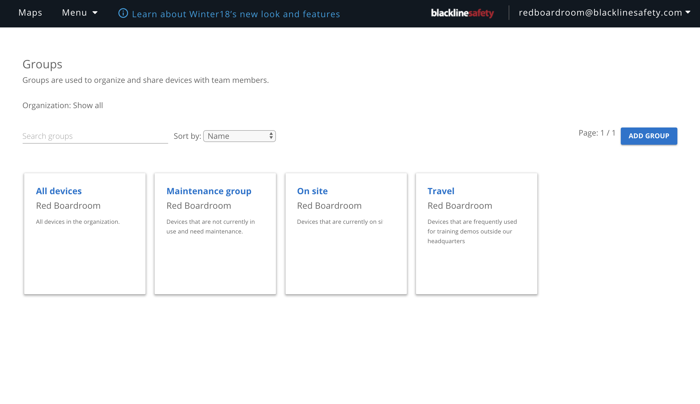
GROUPS
Notes:
Groups
Bundles of devices
You can customize what access your org’s account users have over each group
Flexibility in terms of use – can separate based on sites/teams, function (maintenance/stock ect.), reports ect.

Slide 11
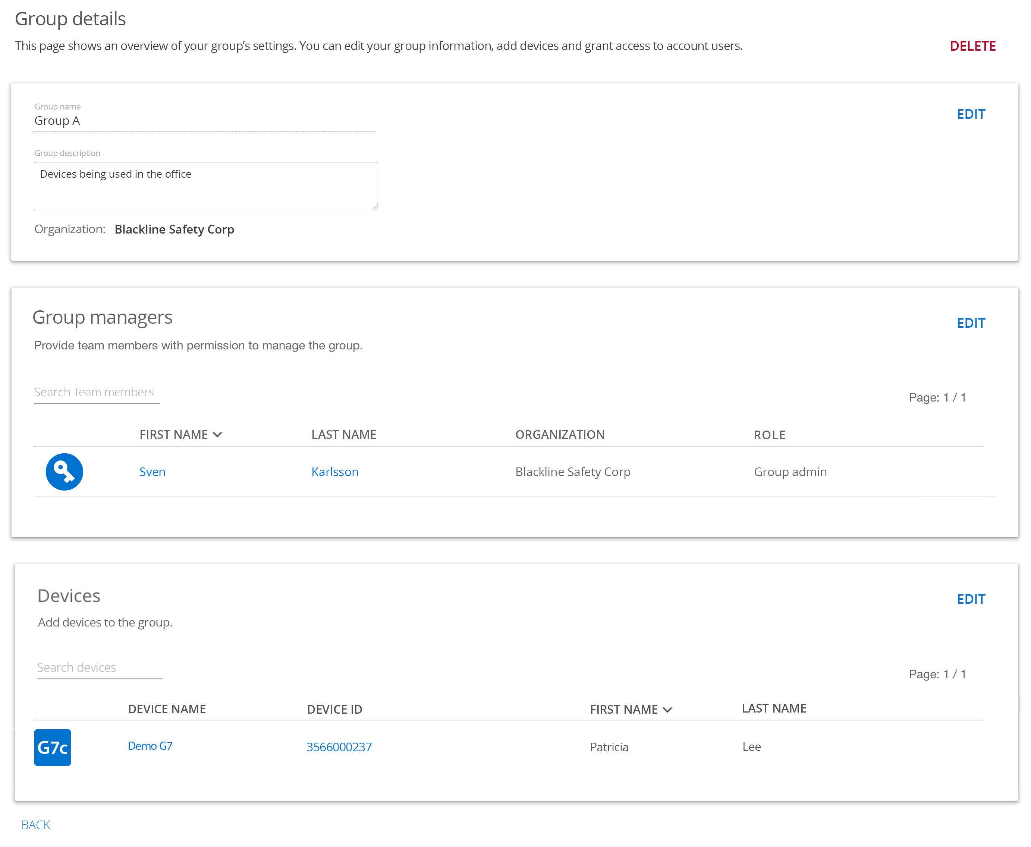
GROUPS
Notes:
Group details
You can edit identifying group information (name, description)
Assign group manager – these are people who have been given access to see this group. When assigning group managers, you must define their role
Assign devices – devices can be put in groups. The roles that group mangers are given dictates how they can interact with these devices. Devices can exist in multiple groups if needed.

Slide 12
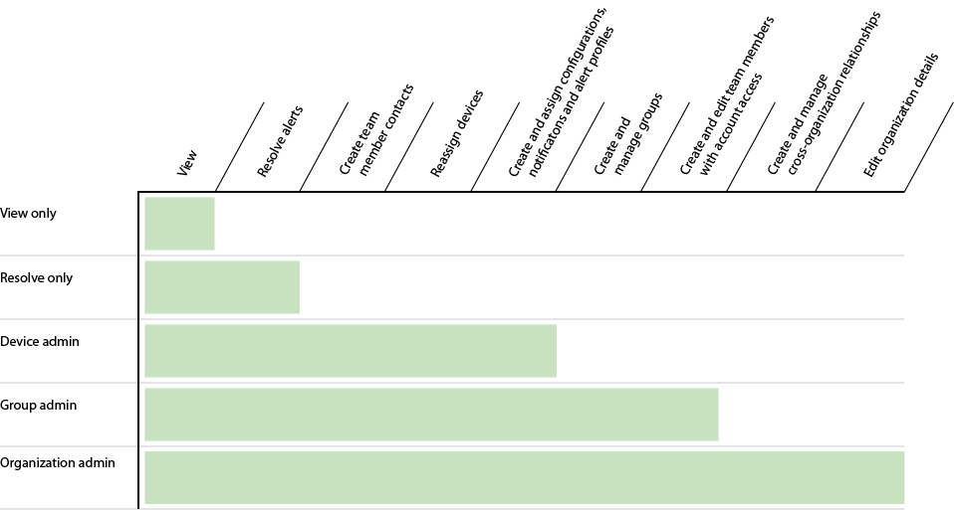
ROLES
Notes:
Roles
Roles are given to account users on a group-by-group basis. These roles define the actions the account users can take over the devices in that particular grou
View only — Best for people who need to see these devices, but can’t change anything on the portal
Resolve only — Best for those who should be monitoring devices. They can see devices and resolve alerts on them, but cannot edit or reassign the devices.
Device admin — Best for those who need the ability to manage devices. They can resolve alerts, edit device names, reassign them and create contacts
Group admin — Best for those who need to manage the group itself, or those who are managers of a team. They can do everything a device admin can, plus they have permission to edit the group itself, including its name/description and who is permitted to see it. They can also create account users.
Organization admin — the highest role in the organization and the manager of the entire organization. They can edit and manage anything in their organization. They are also the only users permitted to edit Org details and manage relationships with other companies. An org can have multiple org admins, but needs at least one.

Slide 13
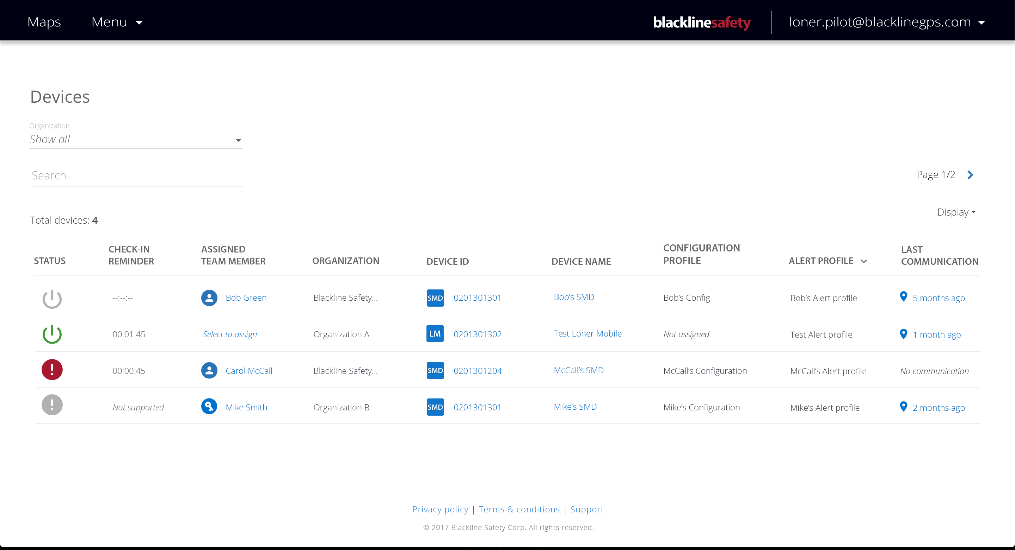
DEVICES
Notes:
An overview of the devices in your organization. Shows live status, check-in and profiles and team members the device is assigned to.
Table can be sorted and searched to find particular devices
Clicking on an assigned team member allows the team member to be reassigned
Clicking on “last communication” links to the history view map where this device was last seen.
Clicking on the Device ID and Name links to a Device Details page with more info

Slide 14
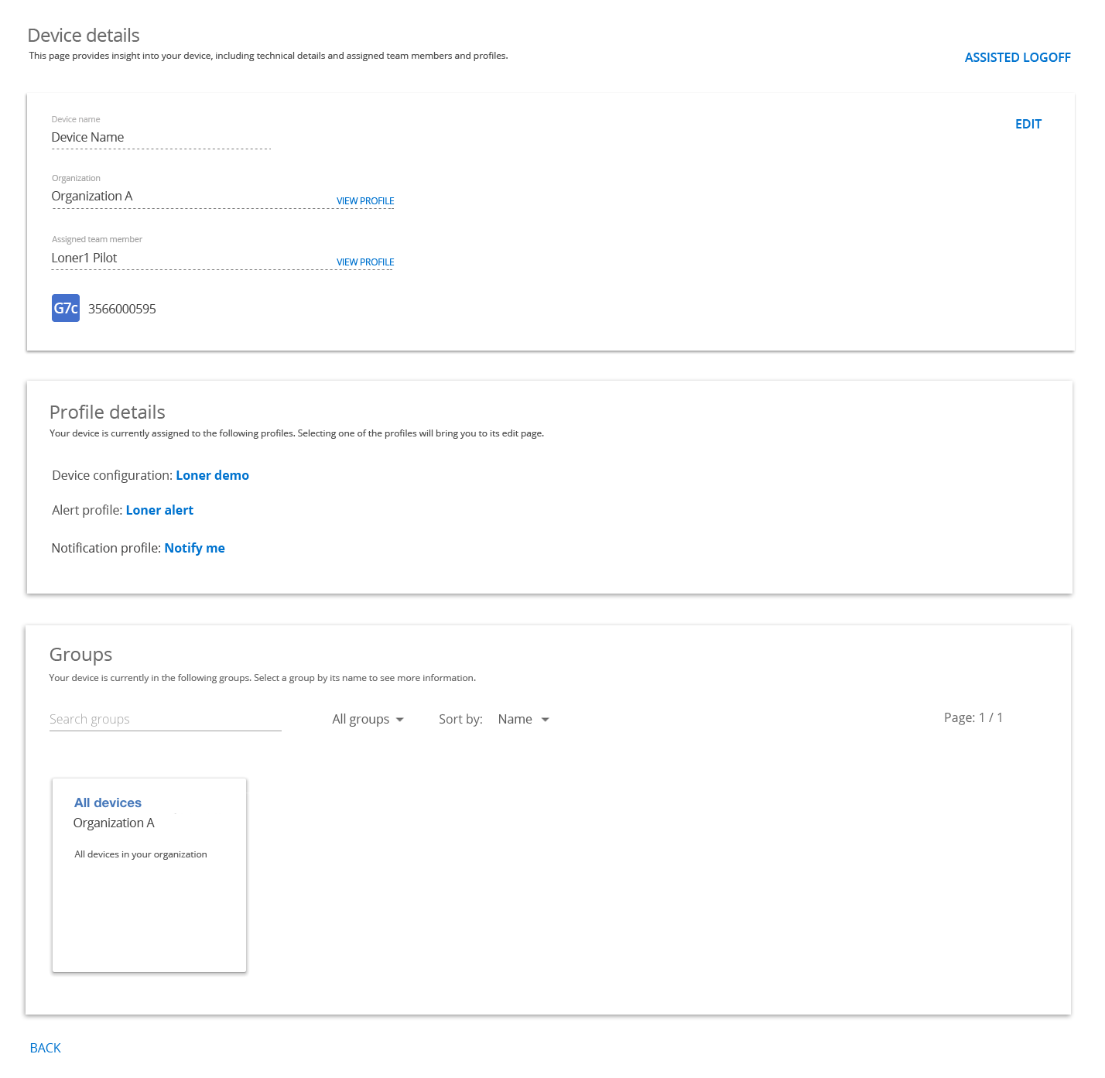
DEVICE DETAILS
Device name
Organization
Assigned team member
Device type and ID
Assigned profiles
Assigned groups
Notes:
Device details gives a collection of information pertaining to a particular device
Identifying information (Name, Org, Device type, ID ect.)
Assigned team member
Assigned profiles (devices configuration, alert, notification)
Can click on a profile name to link directly to that profile
Shows which groups this devices is currently in. Can be searched and sorted to find particular groups
Can click the group name to see that group’s details page.
Groups are optional, so no need to dwell on them

Slide 15
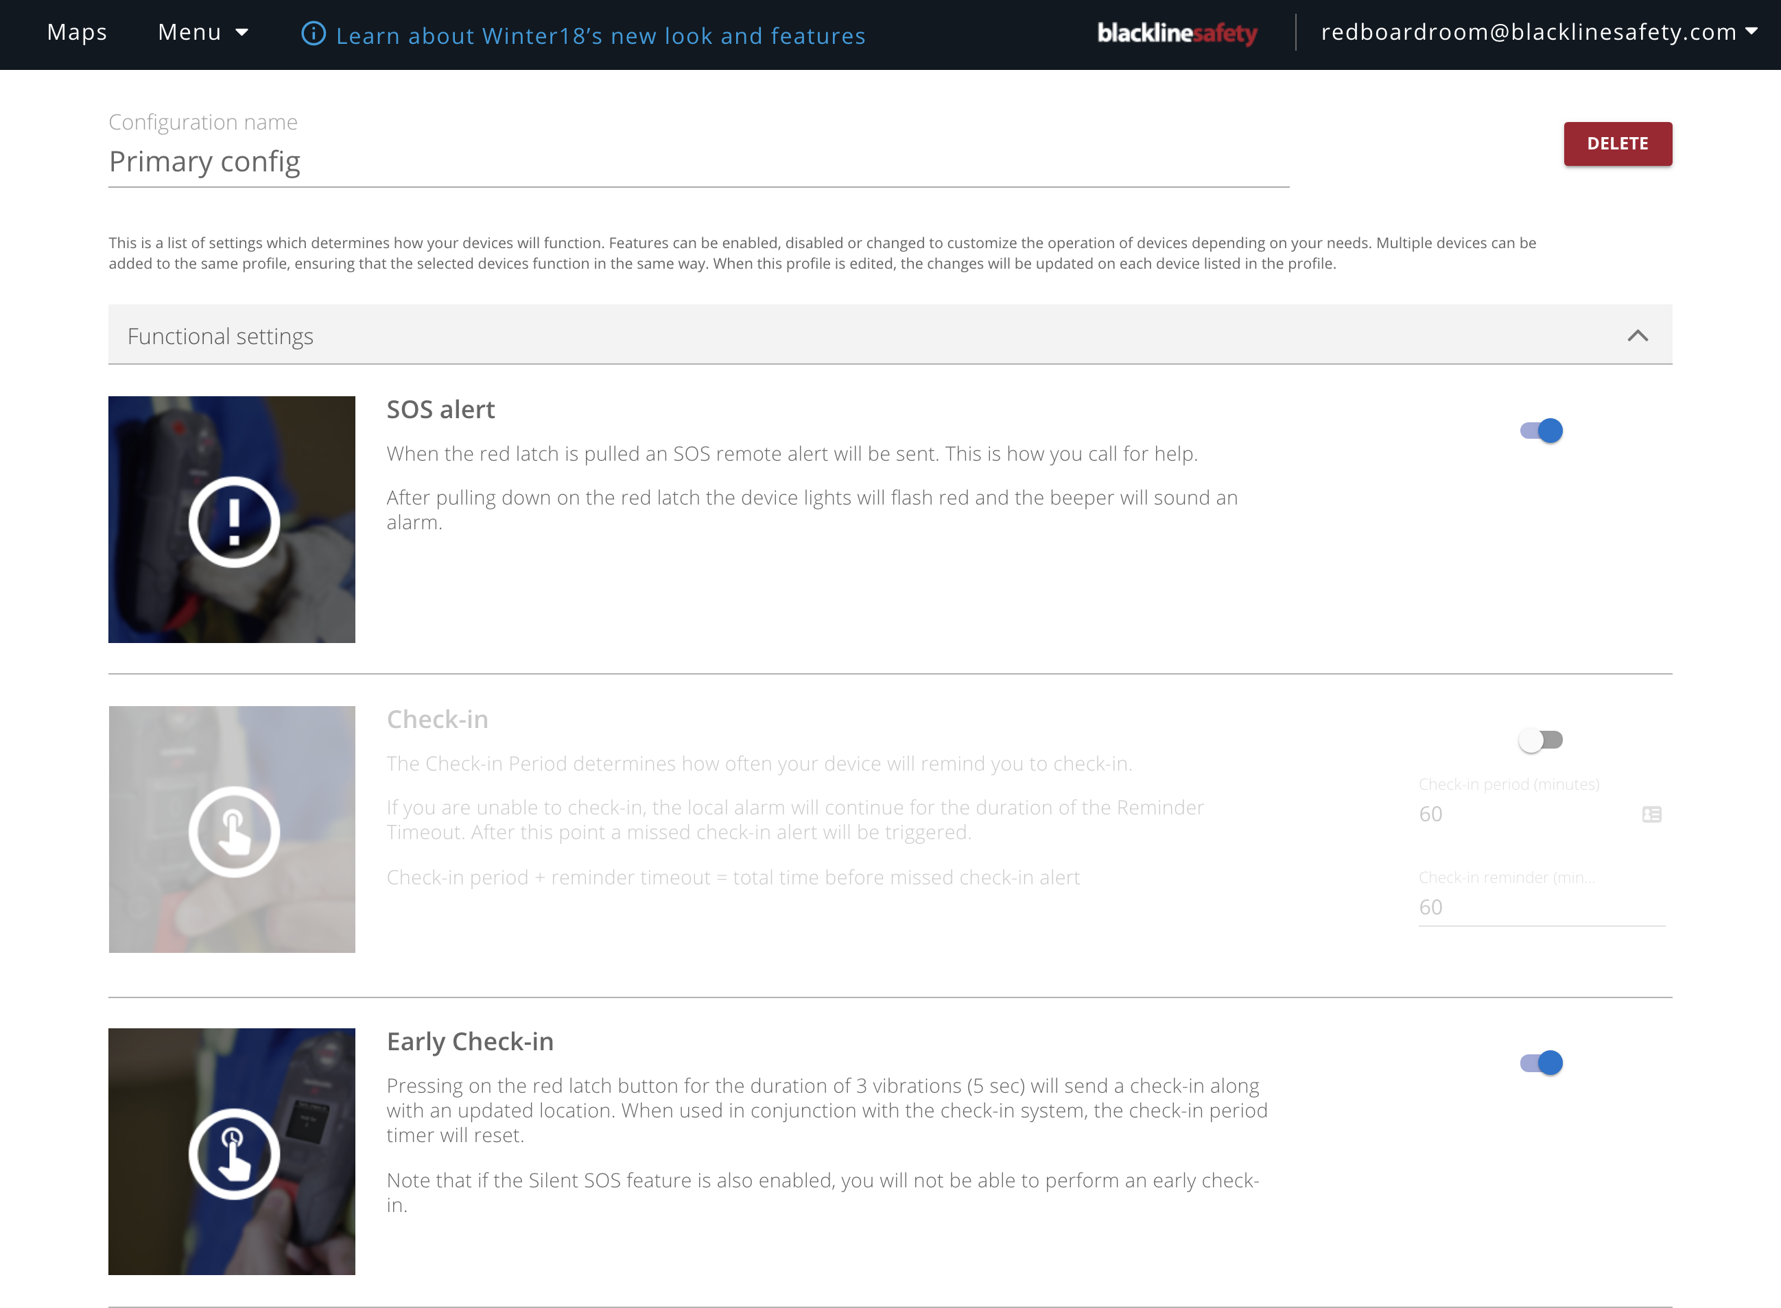
DEVICE CONFIGURATION
Notes:
Device configuration
Define how this define should behave in the field. Enable and disable fields with toggles, enter more specific values by filling out additional text fields or moving sliders.

Slide 16
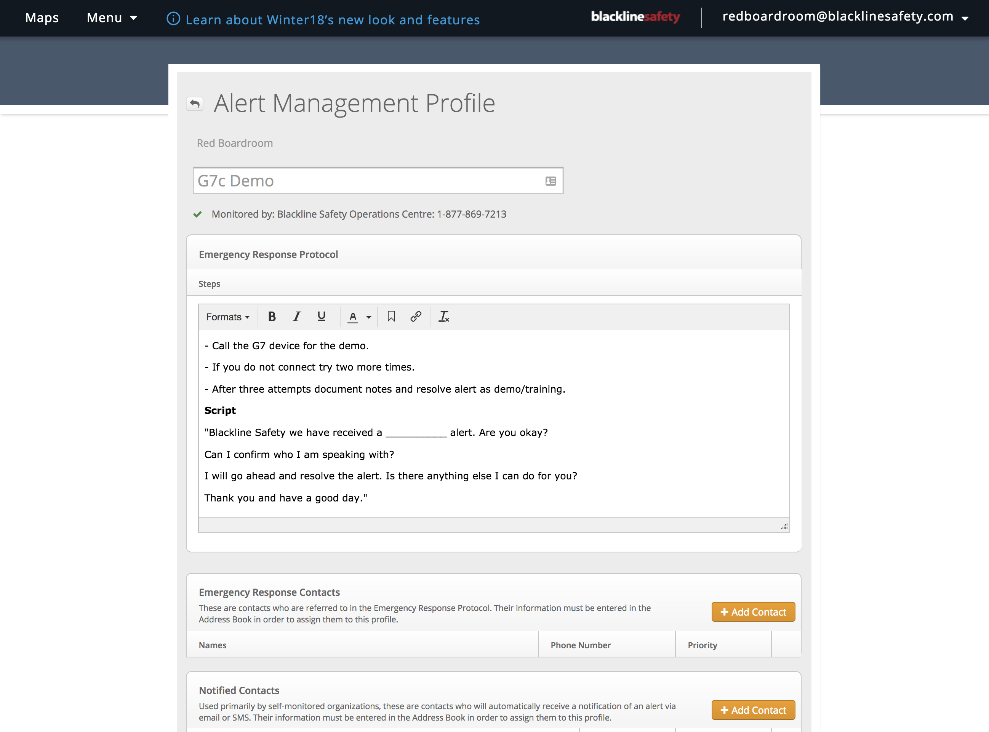
ALERT PROFILE
Notes:
Alert profile

Slide 17
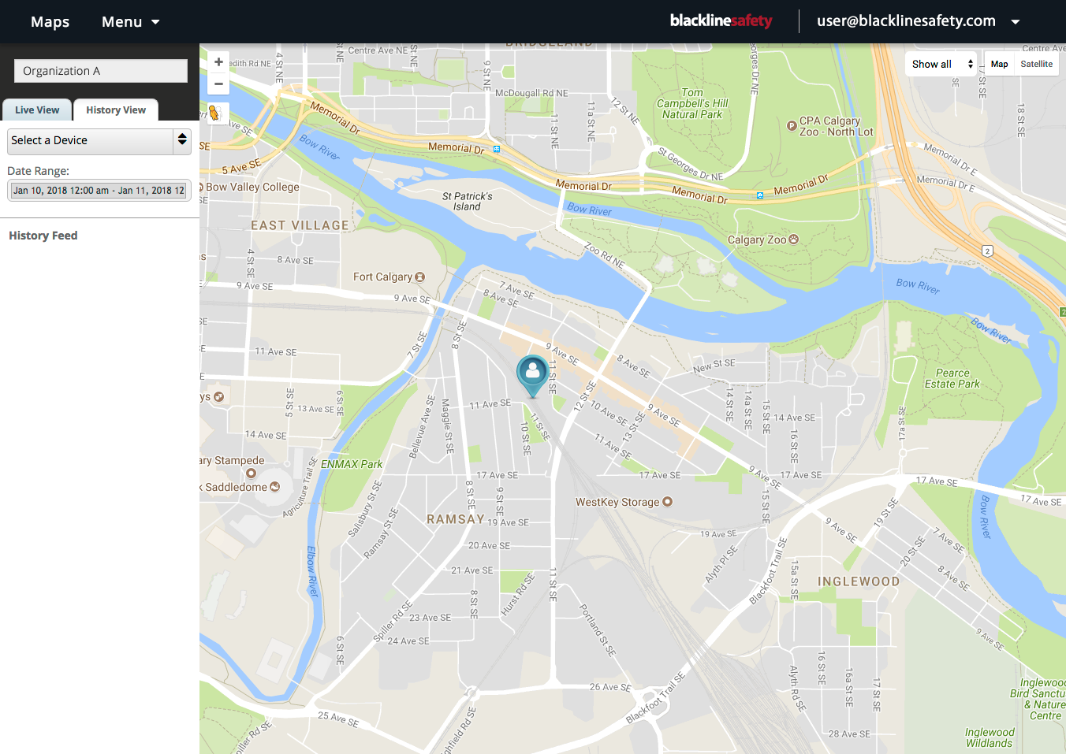
MAPS
Notes:
Maps

Slide 18
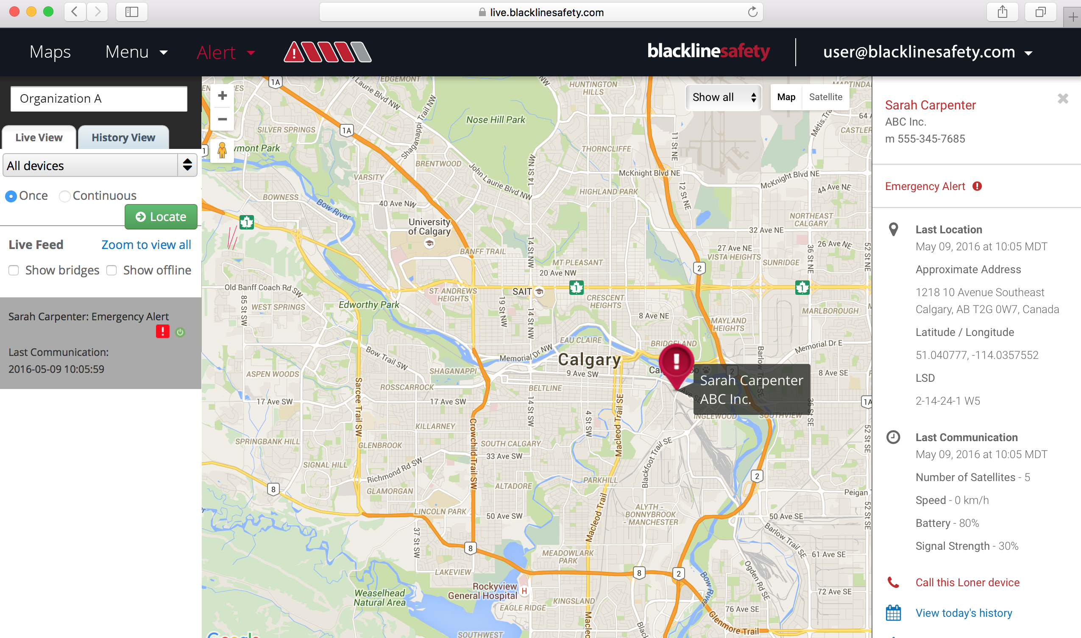
MANAGAING AN ALERT
If your devices are monitored by Blackline or another company, your monitoring service will do this for you.
Notes:
Manage alerts

Slide 19
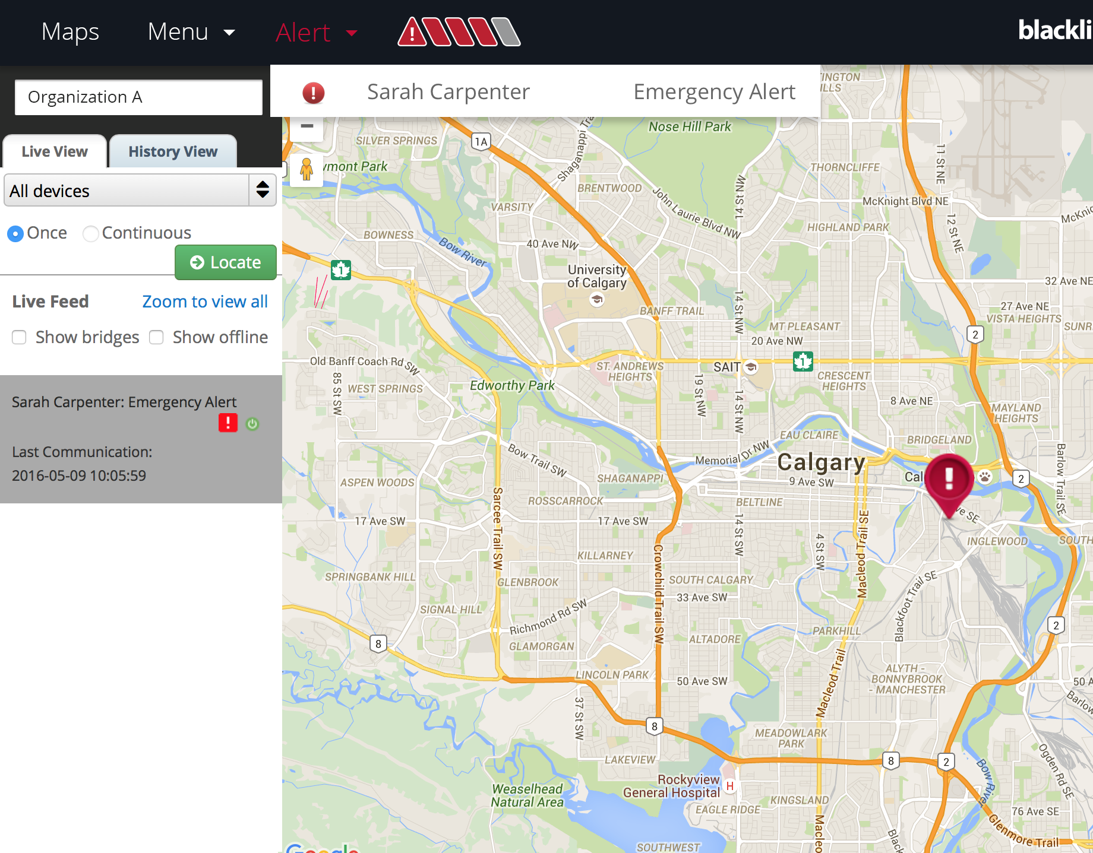
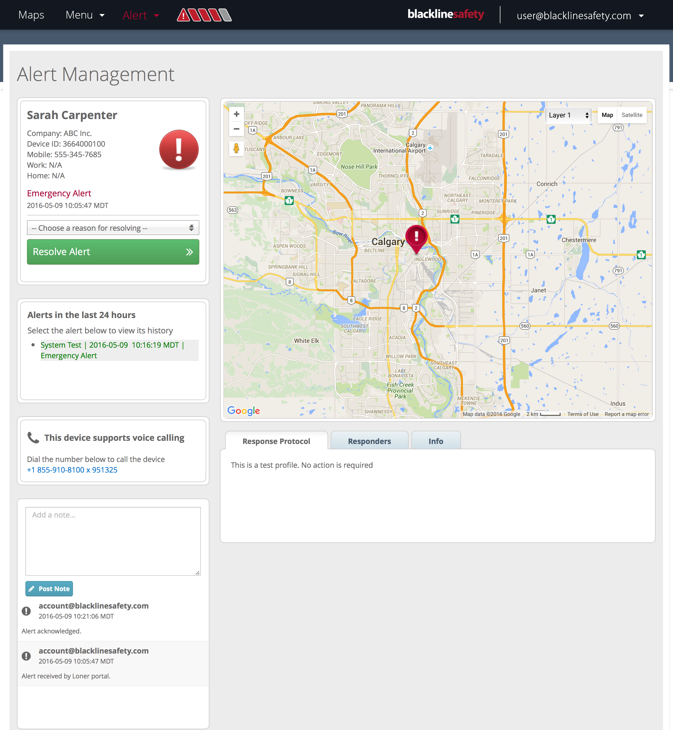
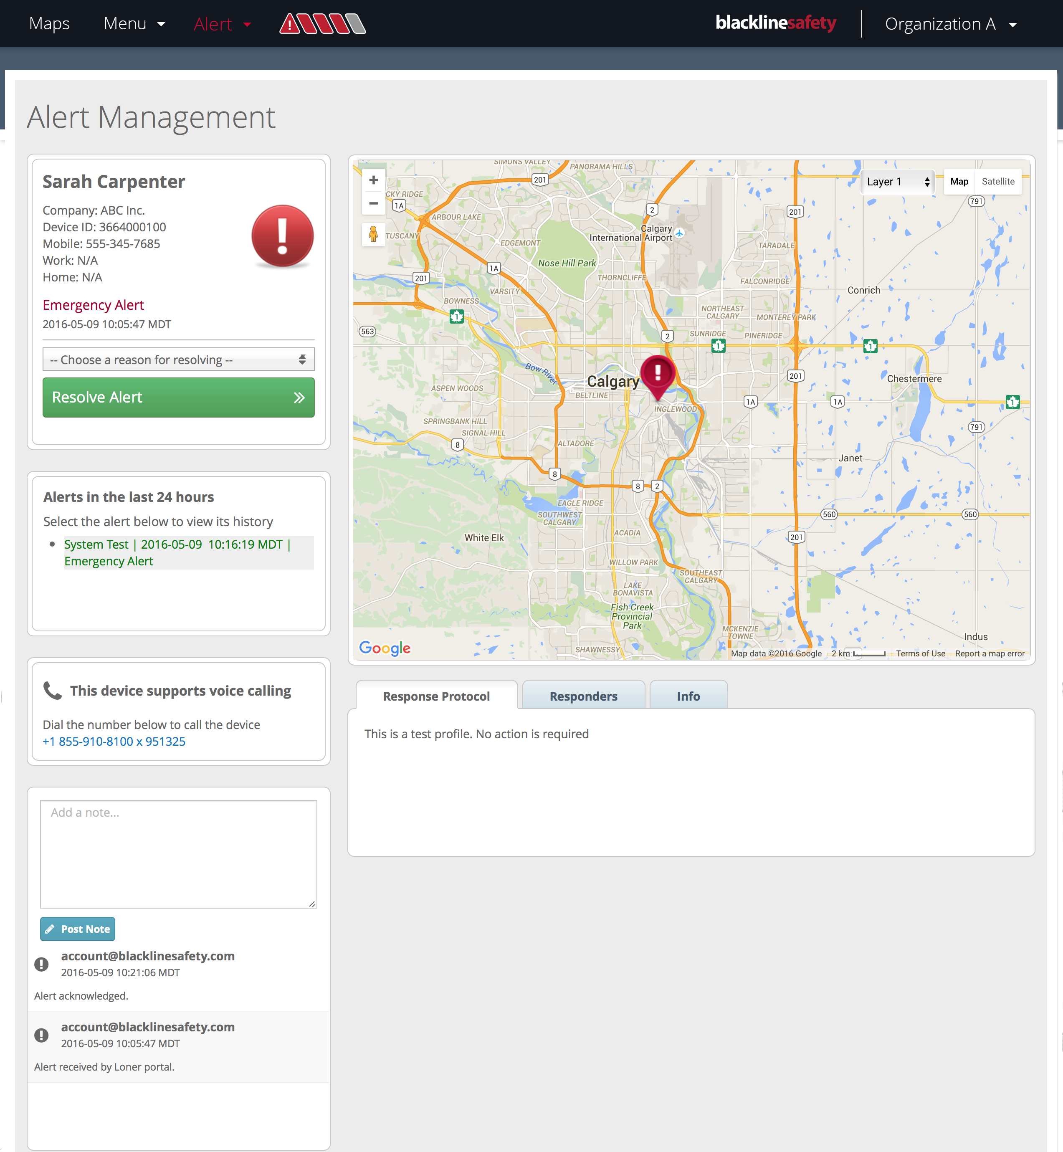
MANAGAING AN ALERT

Slide 21

SUPPORT
support.BlacklineSafety.com
CUSTOMER CARE
For technical support, please contact our Customer Care team.
North America (24 hours)
Toll Free: 1-877-869-7212
support@blacklinesafety.com
United Kingdom (8am-5pm GMT)
+44 1787 222684
eusupport@blacklinesafety.com
International (24 hours)
+1-403-452-0327
support@blacklinesafety.com

