Slide 1

LONER MOBILE VERSION 2.0.0

Slide 2
AGENDA
What is Loner Mobile?
Getting Started
Starting Your Shift
During Your Shift
Notifications
Ending Your Shift

Slide 3
What is loner mobile?

Slide 4
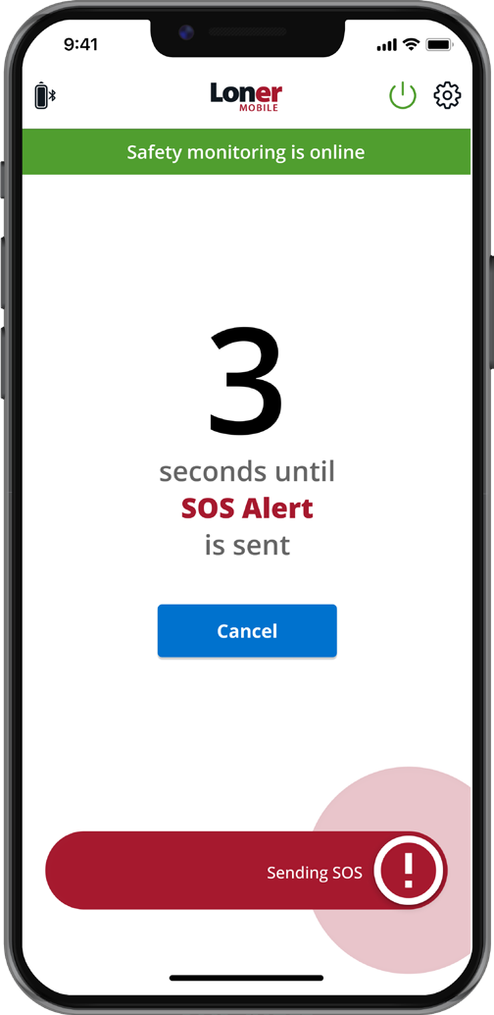
Loner Mobile
Keep lone workers safe and connected—using their own smartphone
Loner Mobile transforms any iPhone or Android into a real-time safety lifeline, alerting monitoring personnel if something goes wrong.
Why Choose Loner Mobile?
Real-Time Monitoring & Emergency Response: Automatically alert monitoring personnel the moment help is needed—enabling a fast, informed response.
Seamless Integration with Blackline Live: Manage users, alerts, and emergency protocols via Blackline Live.
Pinpoint Accuracy When It Matters Most: Deliver live location data so responders know exactly where to go—saving precious minutes.
No Dedicated Devices Needed: Protect your low-risk lone workers using the smartphones they already carry.

Slide 5
Key Benefits of Loner Mobile
Comprehensive safety coverage: Extend your safety net with smartphone-powered coverage across all roles.
Improved operational efficiency: Simplify compliance through a unified platform that centralizes monitoring and reporting.
Cost-effective: Reduce costs by right-sizing safety for lower-risk employees with mobile-based protection.
Peace of mind: Boost confidence in your safety program internally and externally with visible, responsive practices.

Slide 6
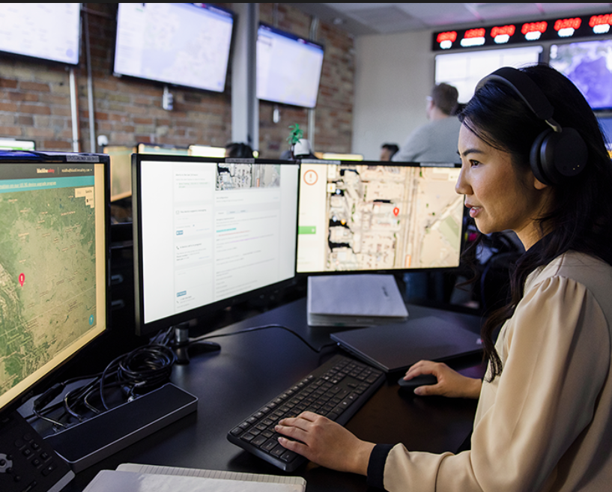
SERVICE PLAN options
Self-monitored
    Your team is responsible to monitor and respond to your alerts 24/7, 365 days a year.
Blackline monitored
    Unlike apps that only notify emergency contacts, Loner Mobile alerts Blackline’s Safety Operations Center (SOC), enabling live monitoring and immediate emergency response to the worker’s exact location.

Slide 7
GETTING STARTED

Slide 8


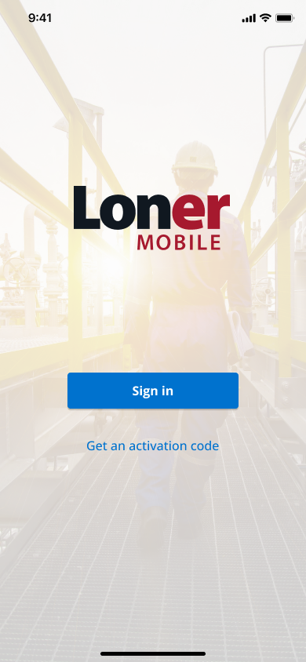
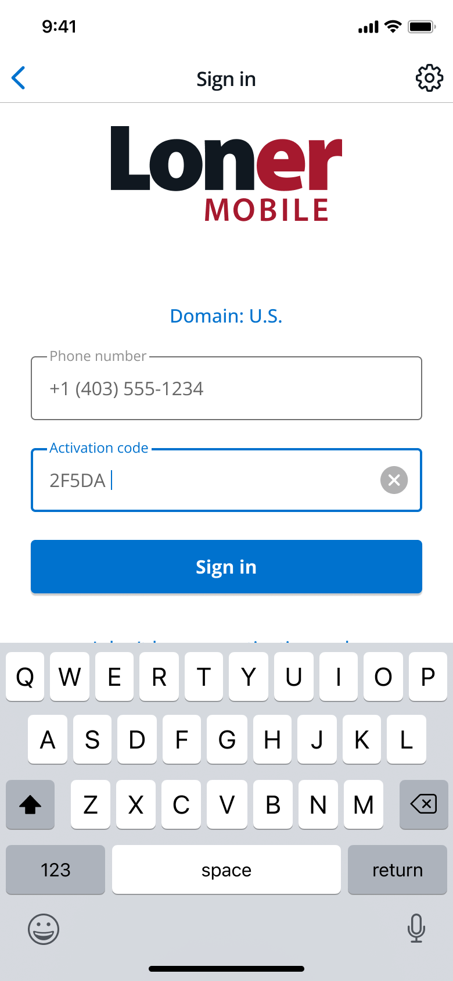

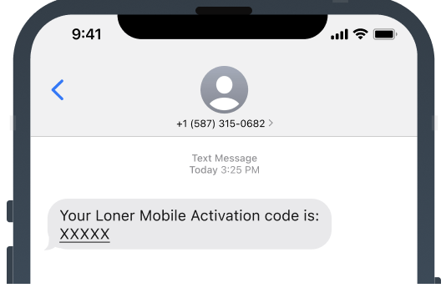
Loner Mobile APP
Getting Started
Getting Started with Loner Mobile
Download the App
  Go to your device’s app store and download Loner Mobile.
Enable Location Services
  To ensure the app works correctly, allow location access when prompted.
Enter Your Phone Number
  Open the app and enter your mobile number.
Enter the Activation Code
  You'll receive a text message with your activation code. Copy and paste it into the app.

Slide 9

SOS Button
Components
SOS Button Overview
The SOS Button is a compact, wearable device that pairs with the Loner Mobile app to:
  Trigger an SOS alert
  Confirm a pending safety alarm
Changing the Battery
  Battery Type: CR2032 (watch-style)
  How to Open: Gently twist the front and back pieces in opposite directions to open the device.
  Having trouble? Visit a watch repair center for assistance.
  Battery Life: Lasts 2–3 months with regular use. The device can stay powered on continuously.
Connectivity and alarm lights
Button

Slide 10
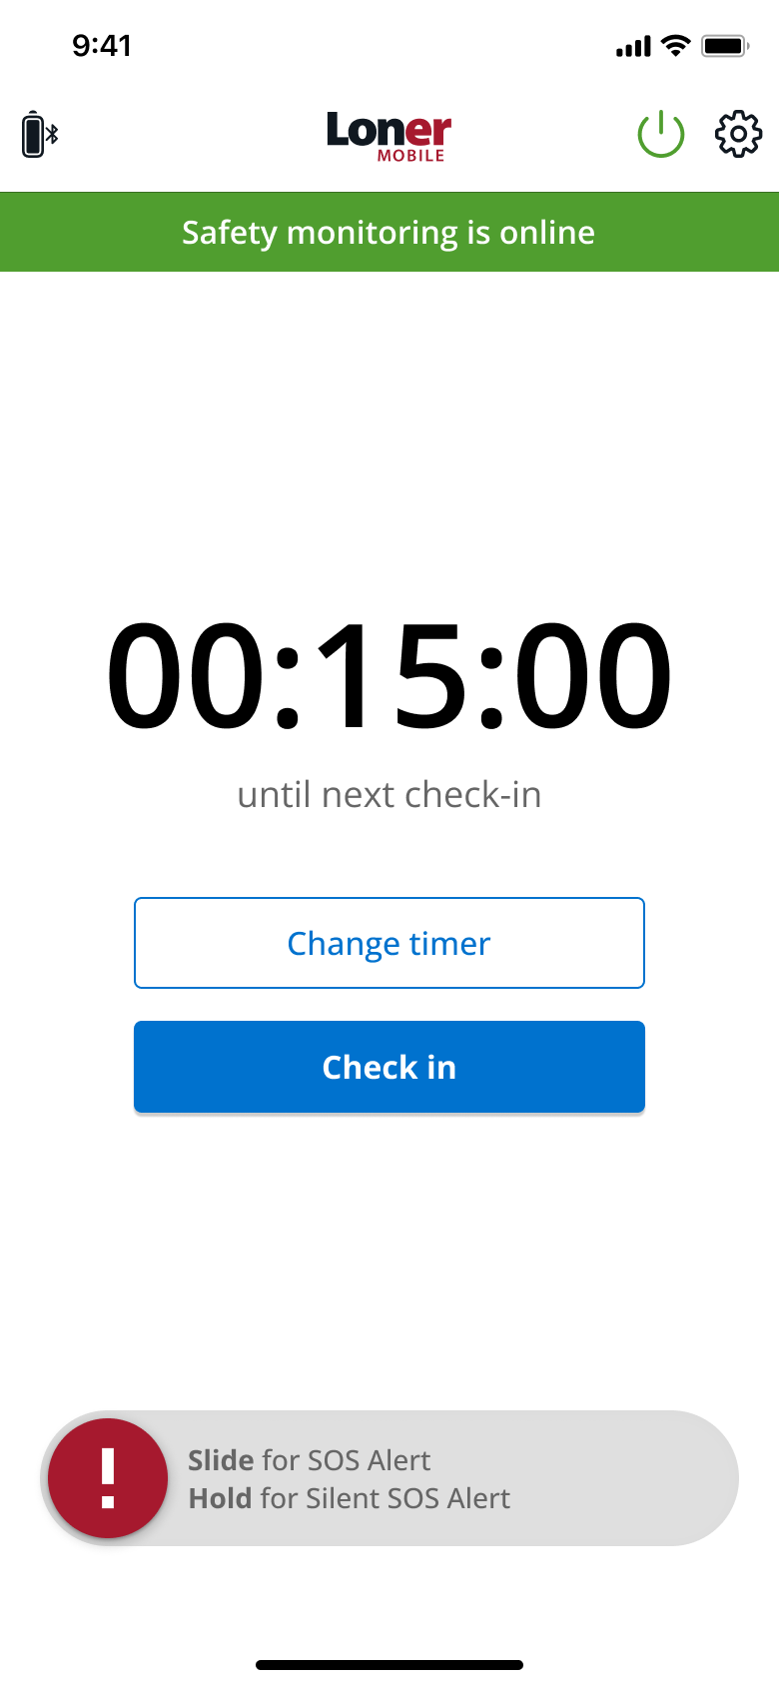
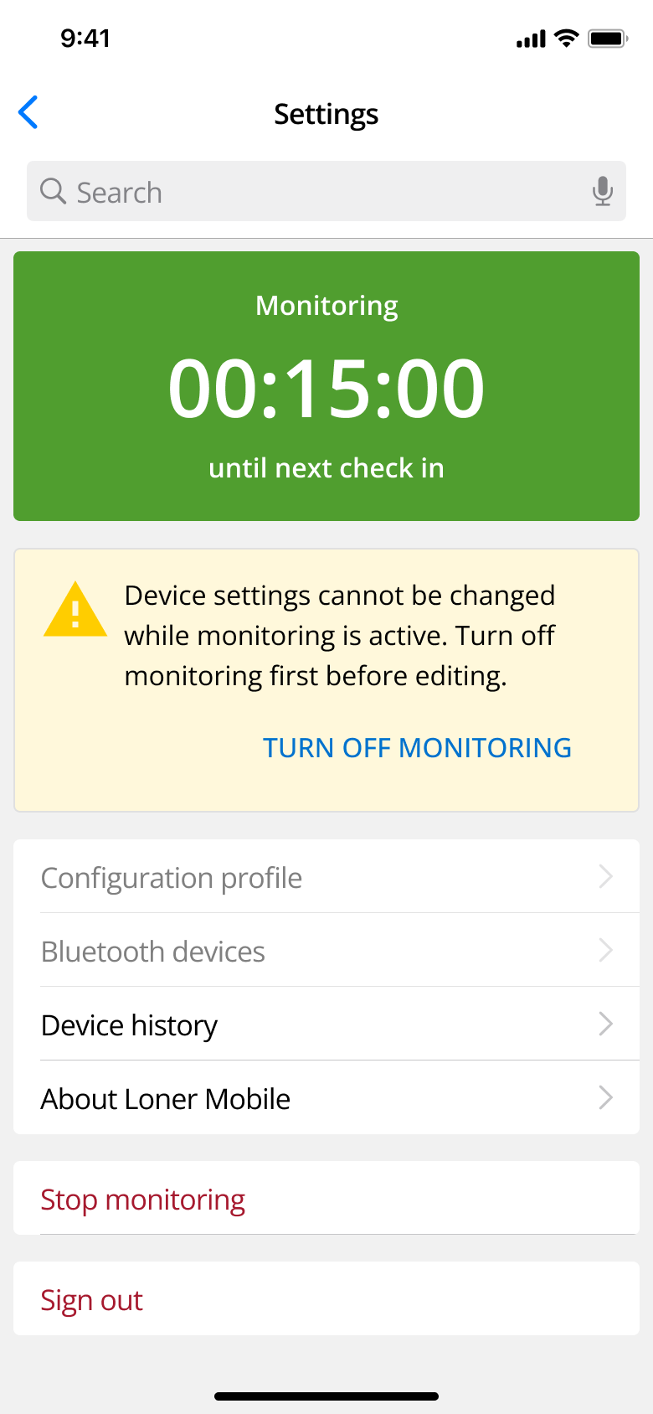
Loner Mobile APP
Settings
Main Screen
Settings Page
View settings
Accessory Battery
Start/stop monitoring
Check in timer
View/edit configuration profile
Check-in button
Pair a Bluetooth device
View device history
Your app version and Blackline's privacy policy
SOS slider

Slide 11
STARTING YOUR SHIFT

Slide 12


Turning on your accessory
How to Pair the SOS Button
Press and hold the button for 10 seconds
Based on your phone’s audio and visual settings:
  The button will chirp once
  A green light will blink every 10 seconds until pairing is complete

Slide 13
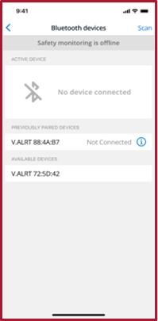
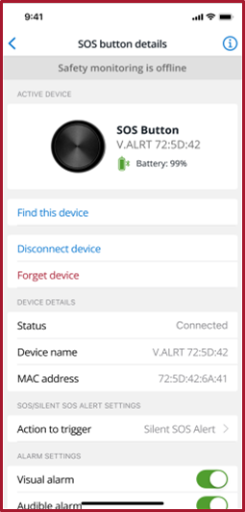
Pairing accessories to loner mobile
Connecting Your SOS Button via Bluetooth
Tap the Bluetooth icon at the top of the Loner Mobile app to begin scanning for nearby devices.
From the list of available devices, select your SOS Button.
Devices are sorted by proximity — yours should appear at the top.
Once selected, the pairing process will begin automatically.

Slide 14
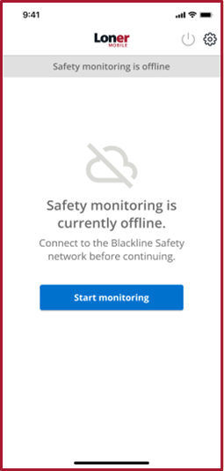
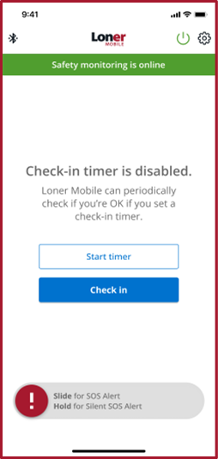
Start monitoring
How to Start Monitoring with Loner Mobile
Press the Power button.
Tap Start Monitoring in the app. Loner Mobile will connect to Blackline Live.
Once connected, your safety is actively being monitored.

Slide 15
DURING YOUR SHIFT

Slide 16
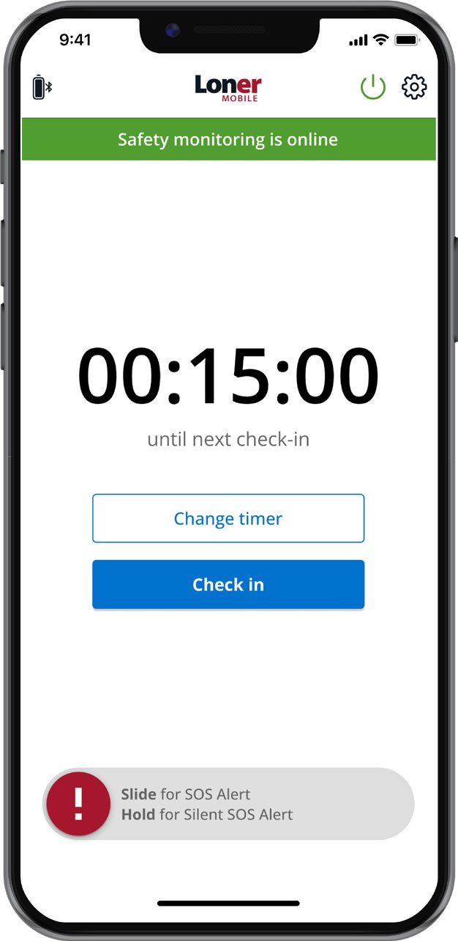

During your shift
Instant SOS and Silent SOS Alerts
Alert Options
Empower your team with immediate access to request help through multiple alert options:
SOS Alert: A manual panic button that sends an immediate distress signal to your monitoring team.
Silent SOS: Discreetly request help without drawing attention, ideal for high-risk or sensitive situations.
Click the Play button to hear the SOS Alert sound.

Slide 17
During your shift
Missed Check-In and No-Motion Alerts
Missed Check-in
The check-in timer counts down and displays the time remaining until your next check-in. When a check-in is required, a pending alarm sounds. If the pending alarm is not acknowledged within the set time, it will then create a high urgency notification, which will be sent to the monitoring personnel.
No-Motion Alert
An alarm will be automatically triggered if the user becomes unresponsive or motionless. The device worn on the person detects lack of movement, providing a critical safety feature for lone workers or those in hazardous environments.

Slide 18
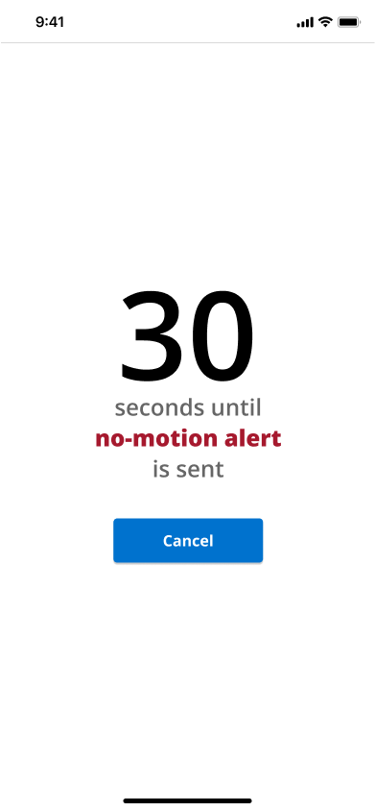
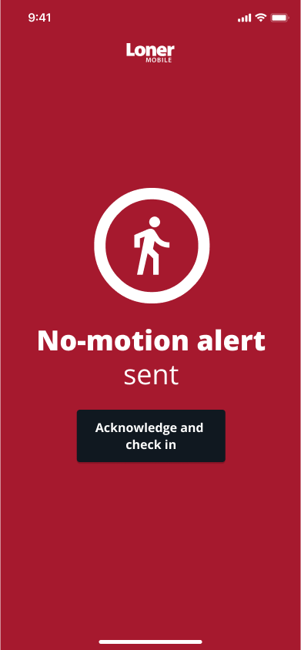
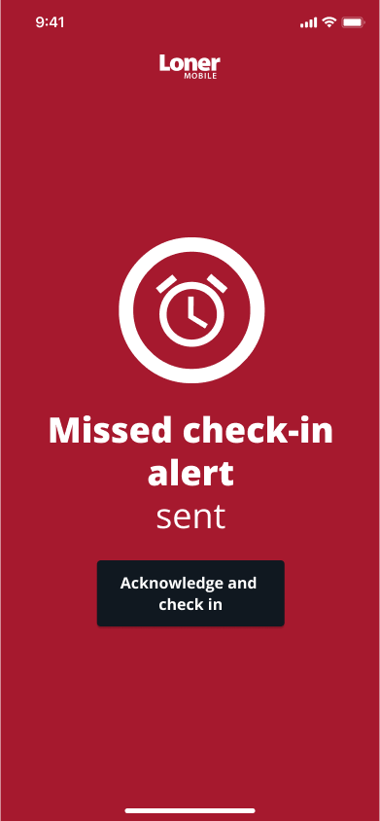
During your shift
No Motion Detection
If a smartphone is attached to a worker’s body, it can continuously detect movement to monitor their activity.
If the worker stops moving for a specified period—suggesting a fall, unconsciousness, or injury—the phone will trigger a pending no-motion alert that can be cancelled if movement resumes.
Click the Play button to hear the no-motion detection sound.

Slide 19
During your shift
Automated Check-In
Automated check-in timers keep tabs on workers’ well-being throughout their shift. It sets customized check-in intervals based on job role, environment, or risk level.
Workers confirm their safety at each interval from the app. If a check-in is missed, an alert is triggered immediately, prompting monitoring teams to investigate.
This eliminates manual tracking and ensures real-time awareness of employee status in the field.

Slide 20
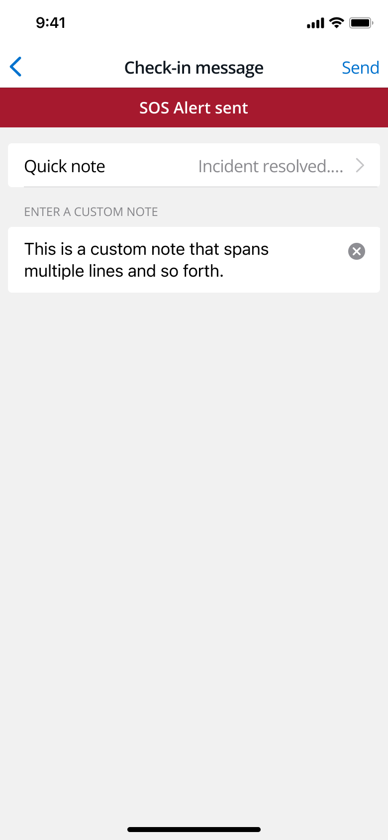
During your shift
Custom Location-Based Notes
Enhance situational awareness for monitoring teams and add custom notes tied to specific locations such as
  High voltage area
  Slippery stairs
  Remote site – no cellular
Notes help responders understand the context and potential hazards associated with a user’s location.
Improve communication and reduce response time during emergencies.
Enable proactive safety monitoring with an early check-in function for users.

Slide 21

During your shift
SOS Wearable Button Accessory
For added convenience and accessibility, a compact, wearable SOS button can be paired with the mobile app
Allow workers to trigger alerts even if their phone is inaccessible (in a pocket, on a belt, or dropped)
Cancel pending alarms
Wearable remains within Bluetooth range to send critical signals directly to the Loner Mobile app
Ideal for hands-on work or high-mobility tasks where quick access is essential.

Slide 22
NOTIFICATIONS

Slide 23

notifications
Connectivity
Loner Mobile requires a network connection to monitor your safety.
If there’s a network error, you’ll be notified immediately so you can act. ​
SOS Button Battery Indicator
The Loner Mobile app uses three battery icon colors to show the status of your SOS Button.
Battery life is good
Battery low, have a CR2032 on hand
Change SOS Button’s battery

Slide 24

notifications
Bluetooth Connection
Connection Range: Be sure to keep your device within 2 meters or 6.5 feet of range of the smartphone.
Notification Alert: Your smartphone will immediately display a connection warning so you’re always informed.
Visual Indicators: Loner Mobile’s Bluetooth and battery icons will turn gray if there’s a connection issue.
SOS Button Reaction: The SOS button will chirp and flash green to signal that it’s actively monitoring and ready to respond.
2 meters or 6.5 feet

Slide 25
ENDING YOUR SHIFT

Slide 26
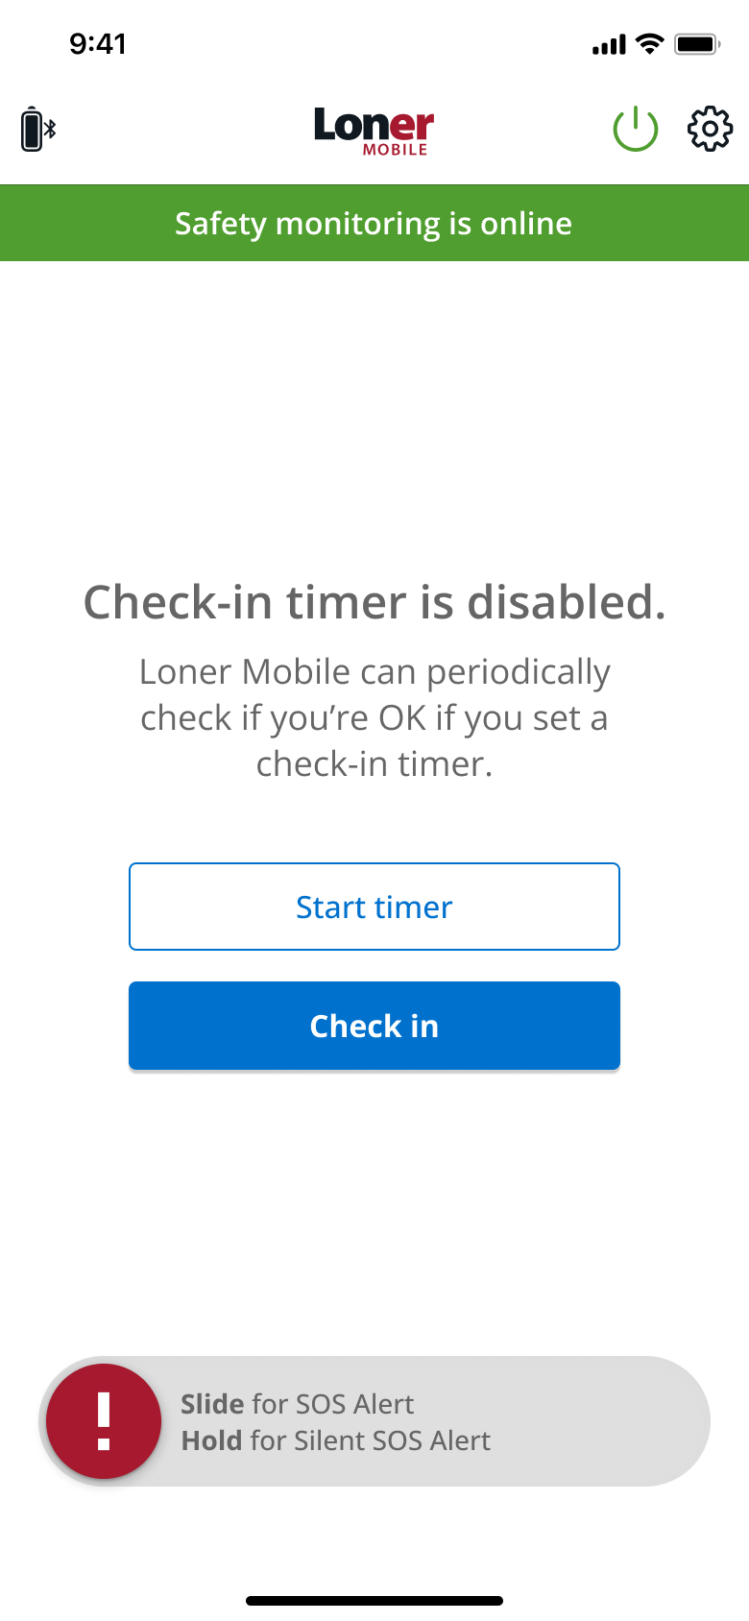
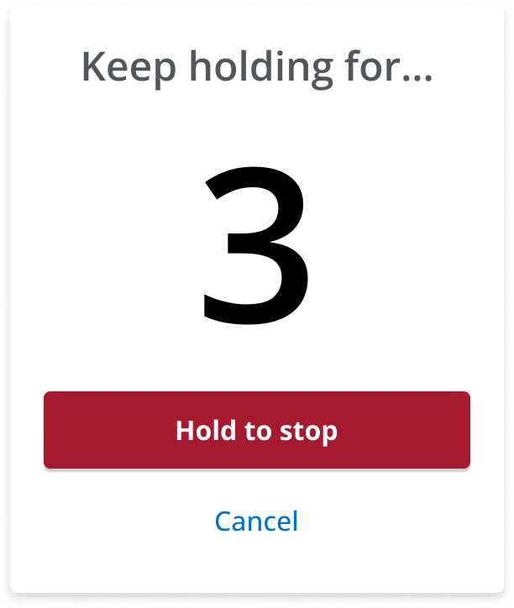
Ending your shift
Stop Monitoring
Logging Off from Loner Mobile
Select the Power Button: Begin by tapping the power icon on your Loner Mobile app.
Press and Hold Stop Monitoring: Hold this button for three seconds to end active safety monitoring.
Status Update: Your smartphone will disconnect from Blackline Live and monitoring will stop.
Stop Monitoring: The app will confirm that your safety coverage has been turned off.

Slide 27
Ending your shift
Turning Off the SOS Button
SOS Button Behavior & Safety Monitoring
Hold the SOS Button for 30 Seconds to turn off the SOS button. Based on your audio and visual settings, the button will blink red and chirp three times to confirm deactivation.
If you turn off the SOS Button before logging out of Loner Mobile, the app will continue to monitor your safety in the background.

Slide 28
CUSTOMER CARE
For technical support and inquiries
North America (24 hours)
Toll Free: 1-877-869-7212
support@blacklinesafety.com
International (24 hours)
Toll Free: +1-403-451-0327
support@blacklinesafety.com
United Kingdom & Europe (business hours)
Toll Free: +44-808-164-5713
support@blacklinesafety.com
Support site link: Contact Us | Blackline Support
Please ensure you have your device in hand and the Unit ID# when calling Customer Care
2025-07-22_R8

