Slide 1




www.BlacklineSafety.com

Slide 2
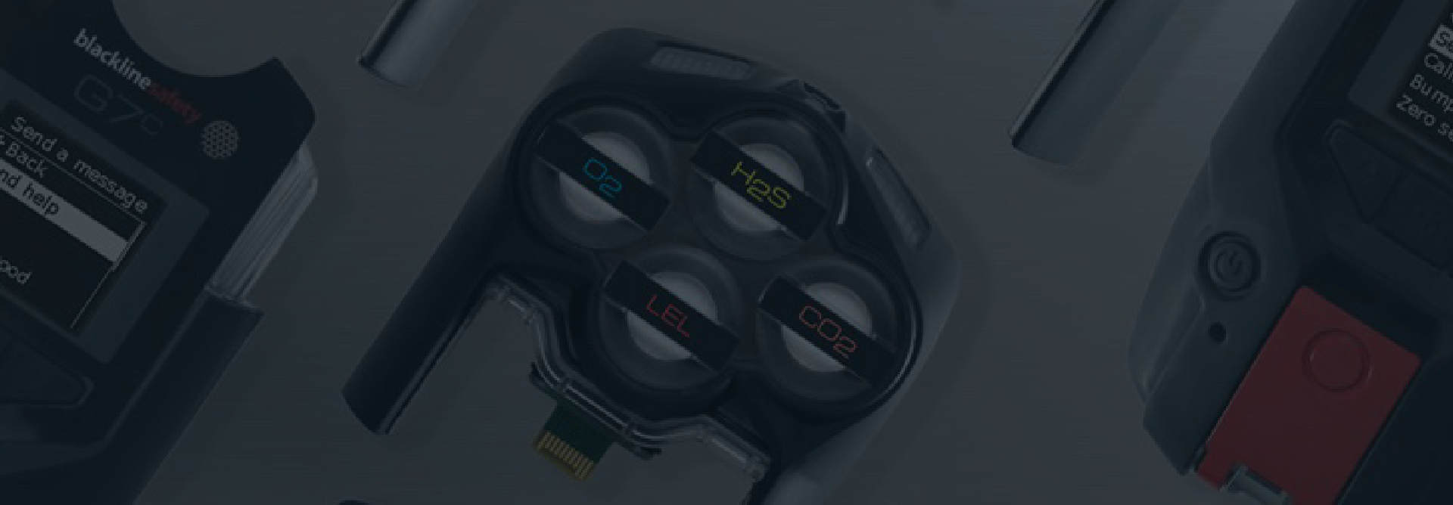
INTRODUCTION
WHO IS BLACKLINE SAFETY?
Headquartered in Calgary, Alberta, Canada
Global connected safety technology leader behind G7
Our talented team of designers and engineers create and manufacture everything in-house
In-house Safety Monitoring Center and Customer Care
We offer services in over 100 countries
Currently monitor over 25,000 employees around the world
We have recorded 26.5 million hours of equipment use and have managed over 850,000 customer alerts

Slide 3
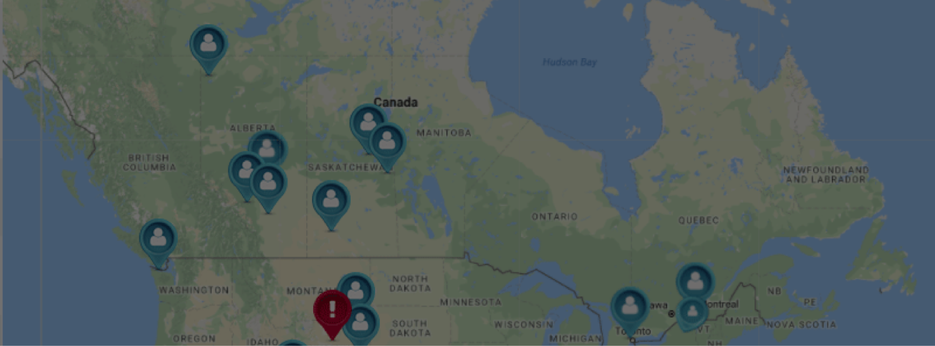
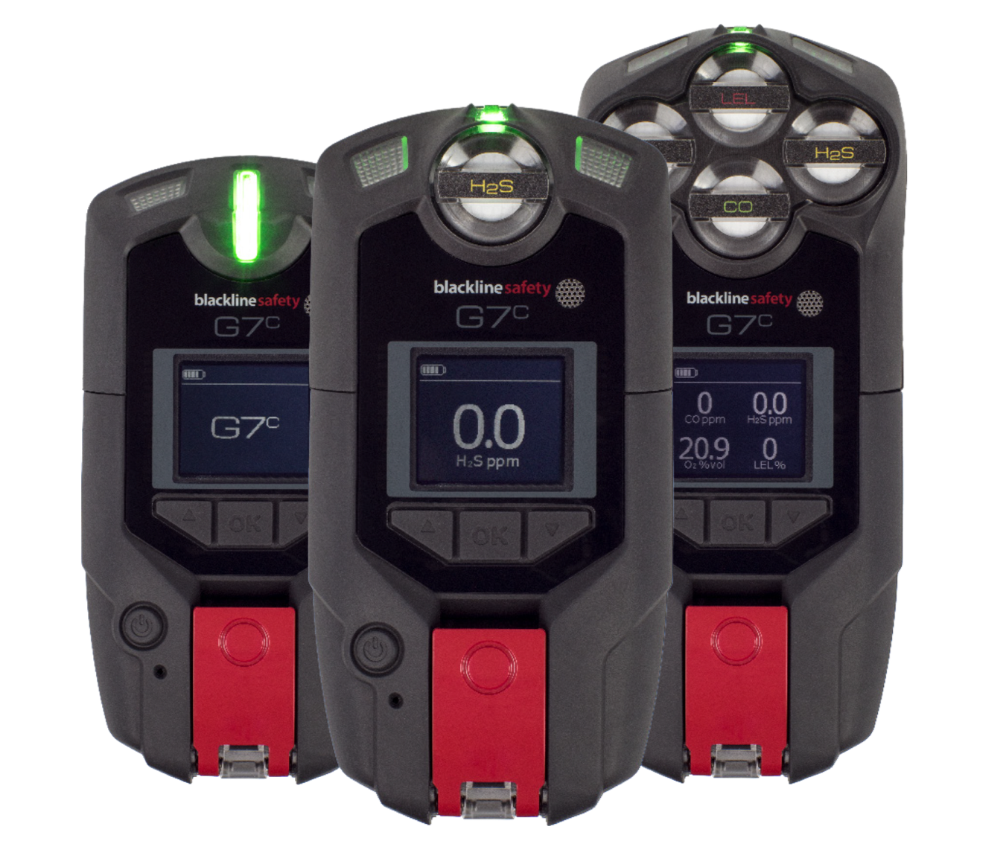
INTRODUCTION
WHAT IS G7?
Standard
Quad
Single
Work-everywhere, wearable, personal safety monitor with gas detection
18 hours battery
2-way texting
2-way voice communication (available to purchase)
Deliver instant situational awareness
Intrinsically Safe

Slide 4

INTRODUCTION
SERVICE PLANS
Self-monitored
Your team monitors your Blackline Live account
Blackline Monitored
Blackline Safety’s in-house monitoring personnel monitor your team 24/7, 365 days a year
99.5% of alerts responded to in under 1 minute

Slide 5

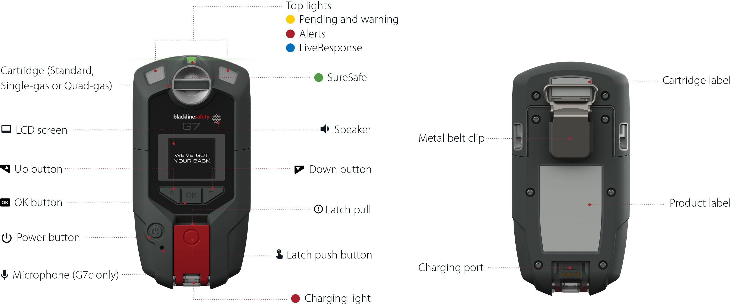
HARDWARE DETAILS

Slide 6
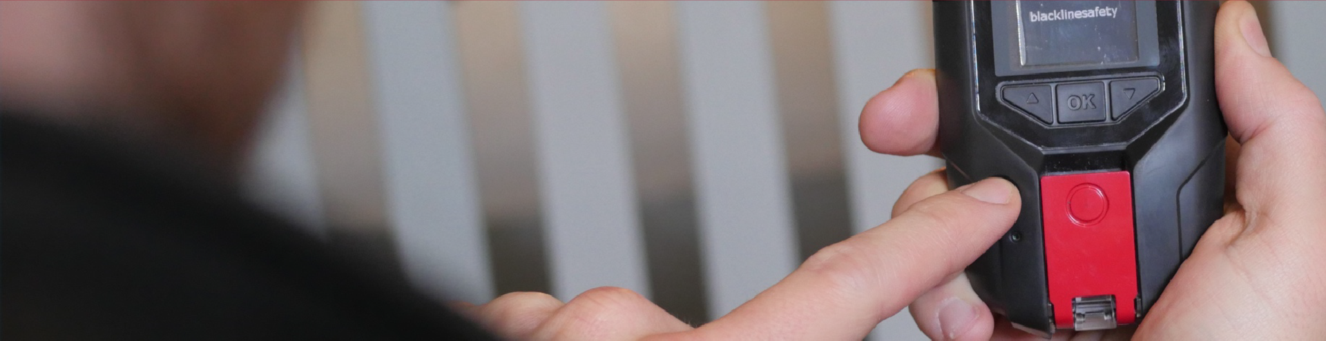
POWER ON
Press the power button once to turn the device on.
SURESAFE LIGHT
A blinking SureSafe Light means your device is trying to connect. Don’t panic! It’s OK to have a blinking light for small amounts of time.
A solid SureSafe Light means you are connected to the Blackline Safety Network.

Slide 7
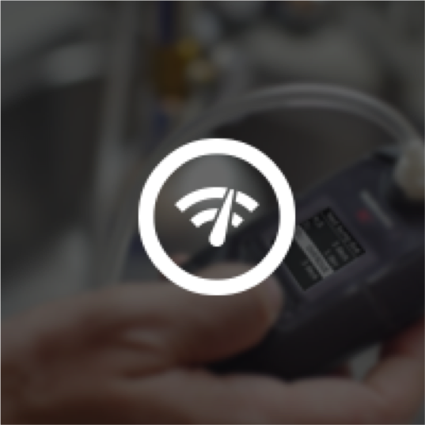
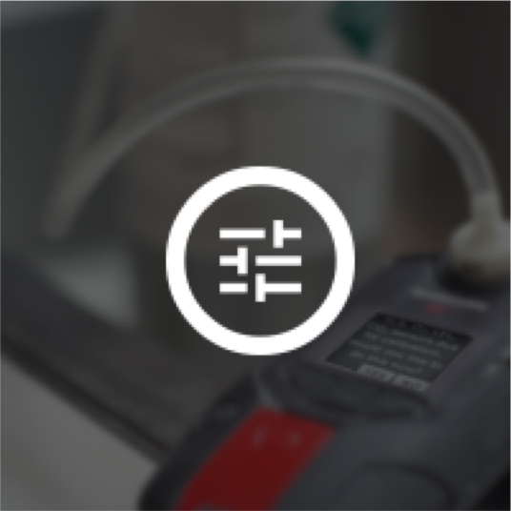
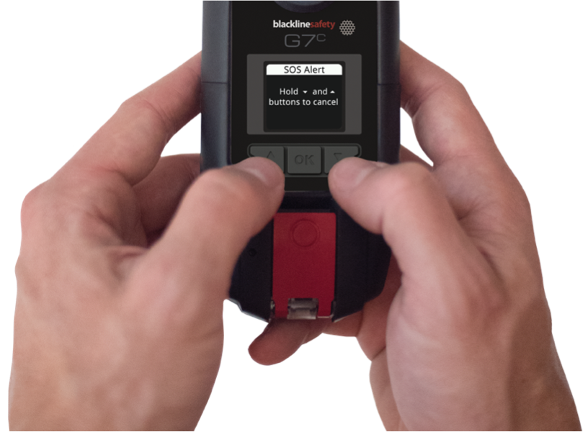

BUMP TEST / CALIBRATION
Bump Test
Calibration
G7 will let you know it’s time to bump or calibrate upon start up.
What do I do?
Press and hold
the up and down arrows to silence this reminder.
Then, bump or calibrate using one of the methods on the next slide.

Slide 8
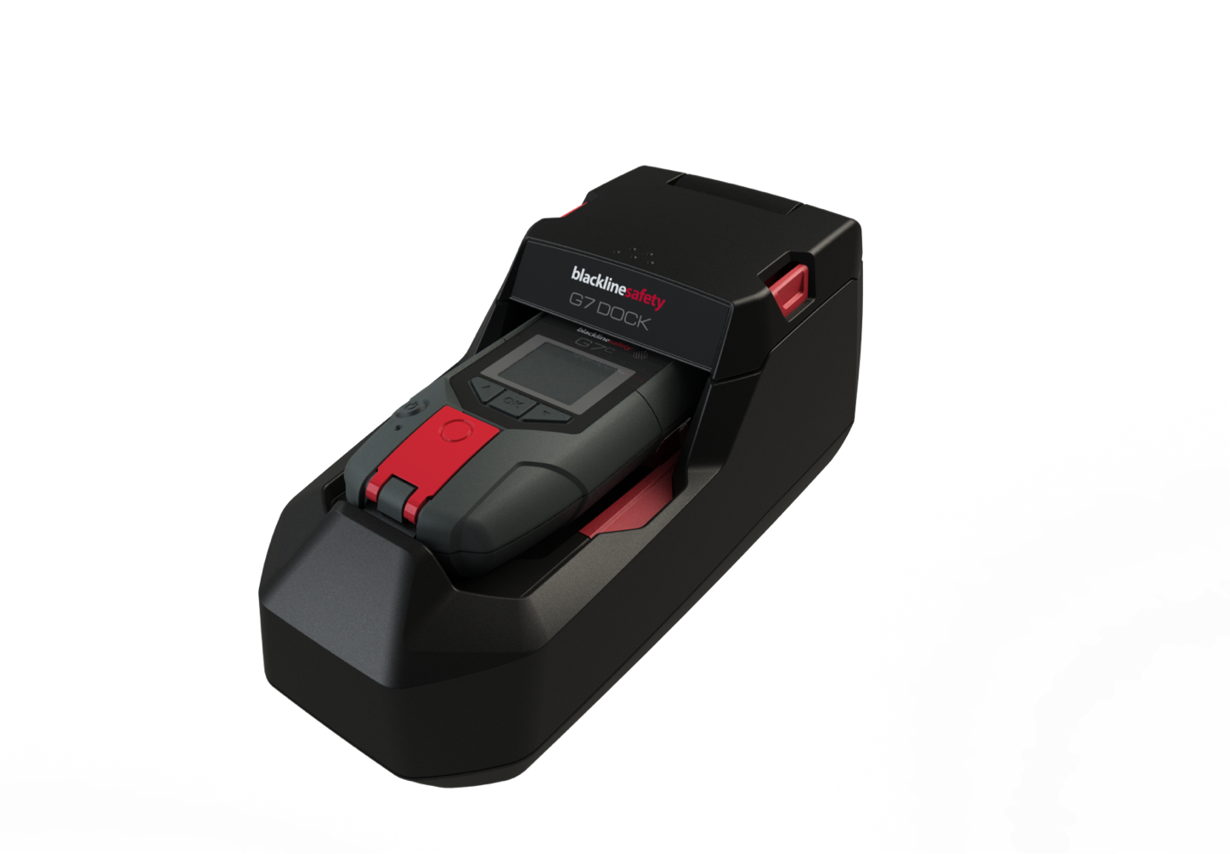
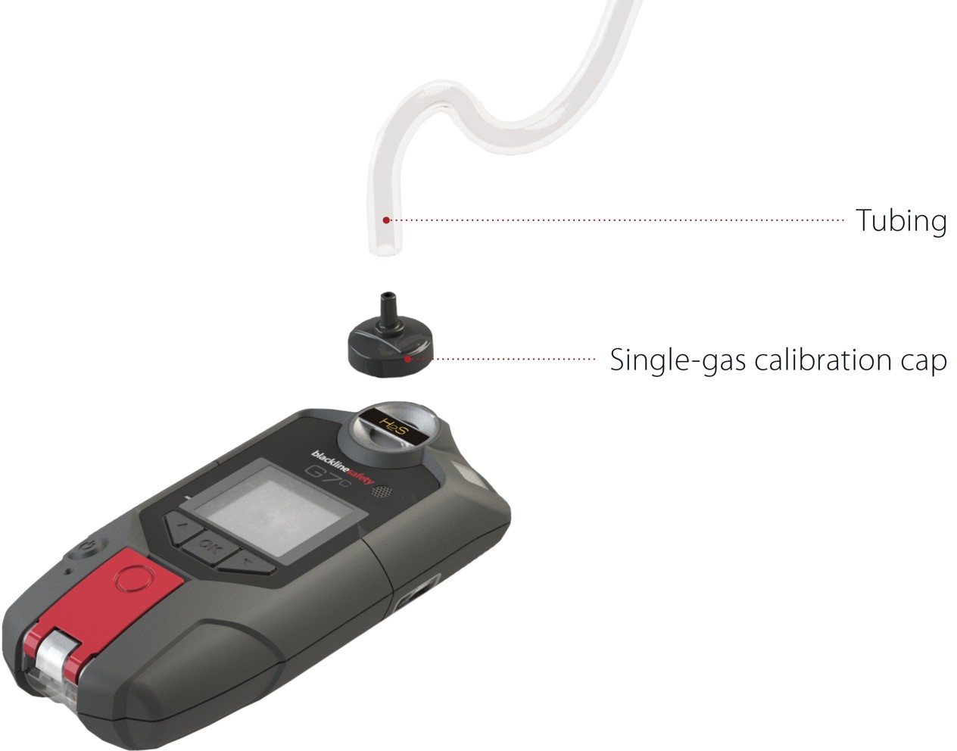
BUMP TEST / CALIBRATION
You can bump and calibrate in one of two ways:
With G7 Dock:
Manually:
Place G7 in dock
Close the lid
Select bump test/calibration from the menu
Let G7 Dock do its thing!
Press OK to access the menu
Use the up and down arrows to navigate to bump test
Select bump test
Follow the steps on screen

Slide 9
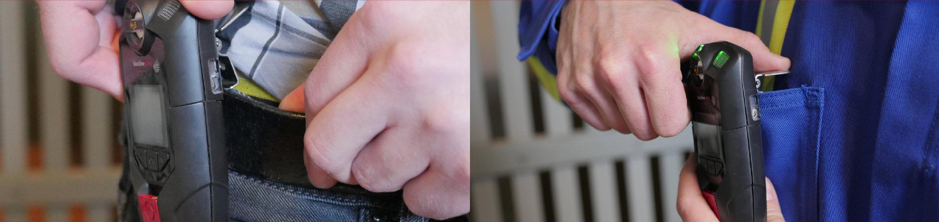
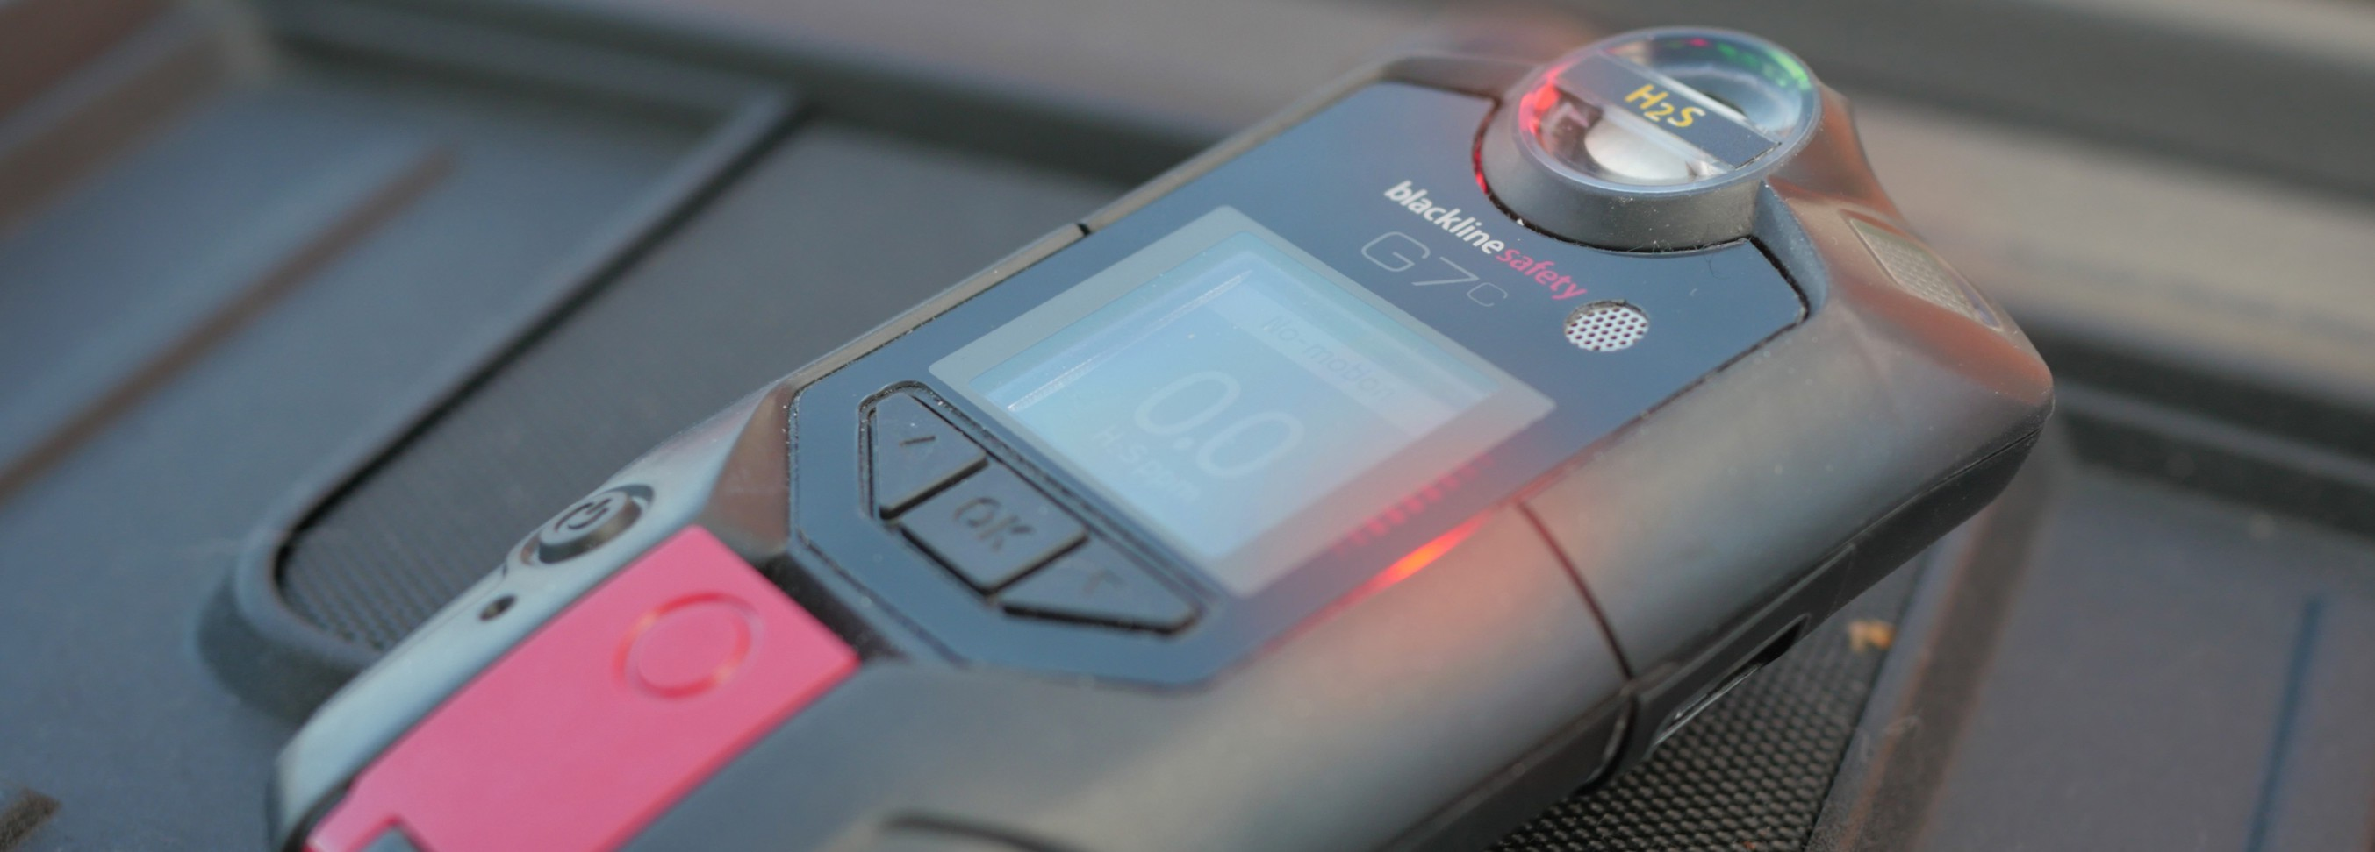
WEARING
Belt
Chest
DO NOT LEAVE G7 UNATTENDED WHEN POWERED ON, THIS CAN LEAD TO FALSE RED ALERTS

Slide 10

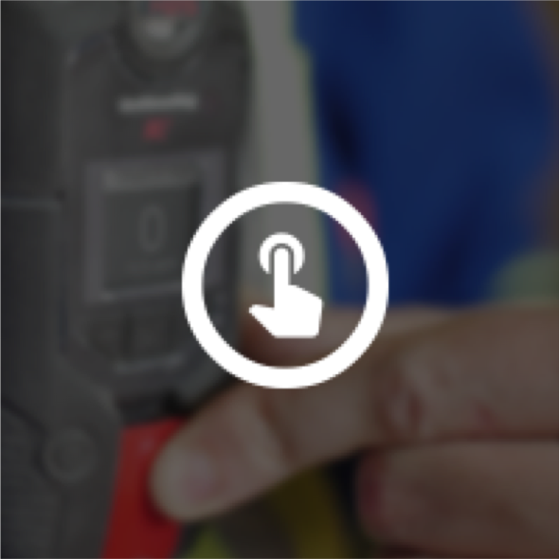
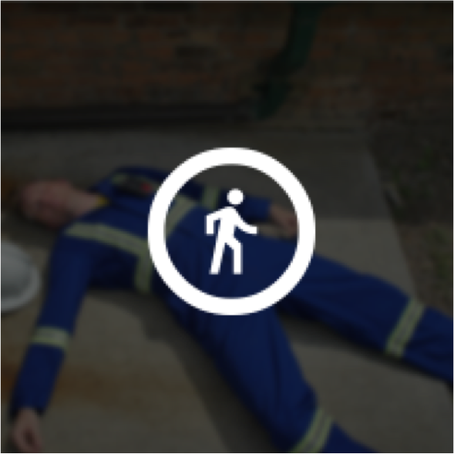

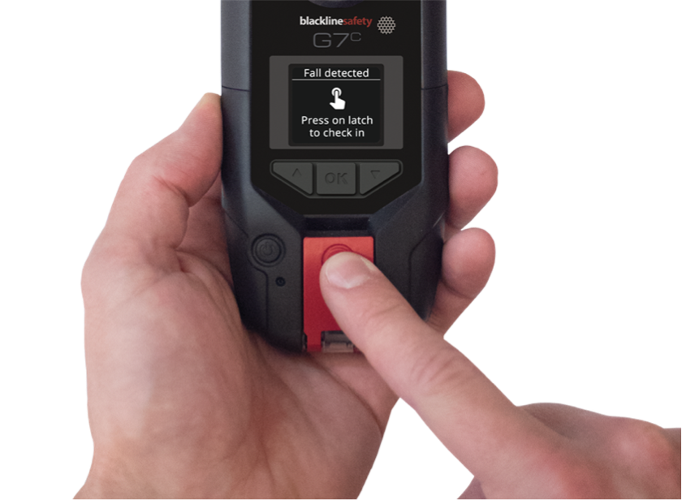
YELLOW PENDING ALARM
YELLOW PENDING ALARM
Fall detection
Check-in timer
No-motion
What do I do?
Are you OK?
If yes, press the latch to return the device to normal function.

Slide 11
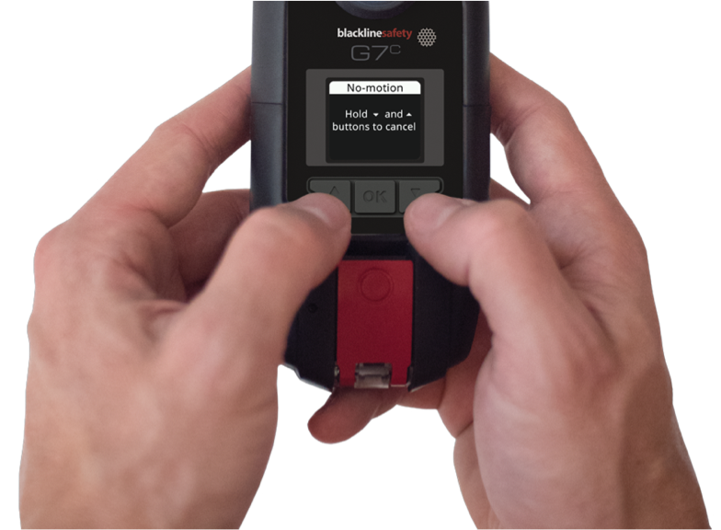

YELLOW PENDING ALARM
What happens if you don’t tell the device you’re OK?
YELLOW PENDING ALARM RED ALERT
If you don’t confirm you’re OK, the Yellow Pending Alarm escalates into Red Alert and notifies monitoring personnel.
What do I do?
Press and hold the up and down arrows to mute the device.
Remember – this doesn’t cancel the alert.

Slide 12

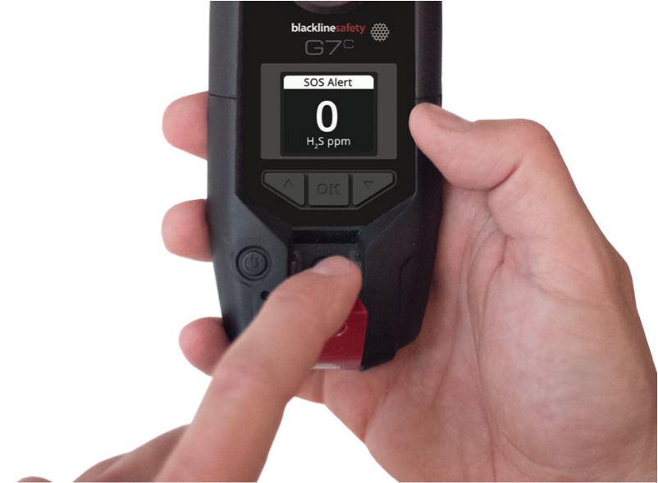


SOS ALERT
If you need to request help right away, you can trigger a SOS Alert.
What do I do?
Pull the latch!
How do I silence the alarm?
Press and hold the up and down arrows.
Remember – this does not cancel the alert.

Slide 13
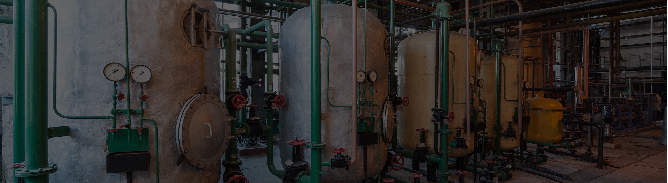






RED GAS ALERT
STEL (SHORT TERM
EXPOSURE
LIMIT)
TWA (TIME
WEIGHTED
AVERAGE)
HIGH ALERT
OL (OVER LIMIT)
G7 is informing you of something dangerous in your environment.
For real-time customers, certain gas alerts will automatically generate a red alert and notify monitoring personnel.
What do I do?
Evacuate the area. When it is safe to do so, press and hold the up and down arrows to mute G7’s lights and sounds.

Slide 14
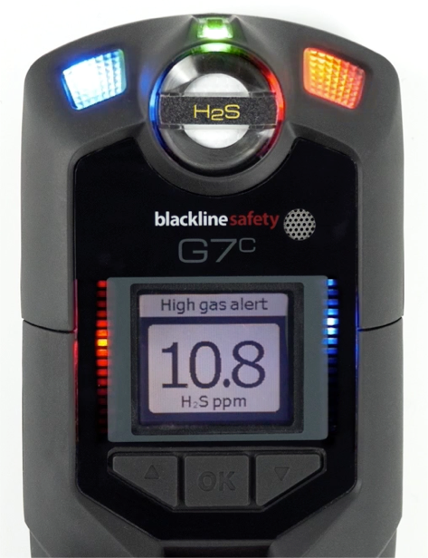

LIVE RESPONSE
LIVERESPONSE
The LiveResponse light will flash blue when monitoring personnel respond to your Alert using your company’s alert response protocol. When it shines on your device, it means someone will be contacting you to confirm you are OK.
What do I do?
Nothing! Wait for monitoring personnel to call or message you, and then let them know if you’re OK or if you need help.
?
Who are monitoring personnel?
Personnel are the Blackline Live Safety Agents or your own monitoring team.

Slide 15
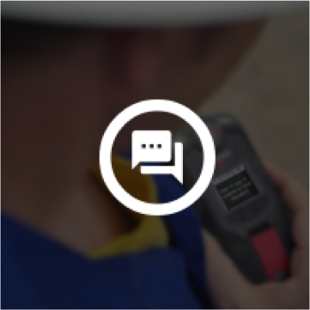

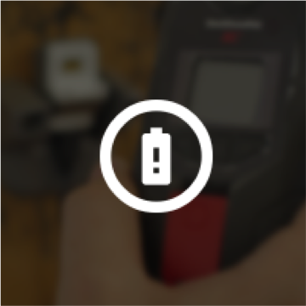
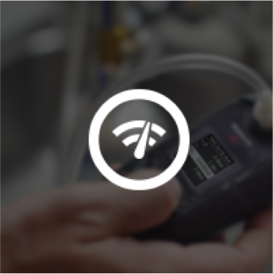
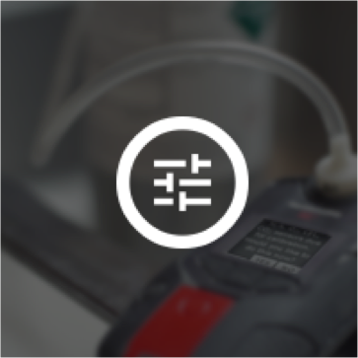



YELLOW WARNING ALARM
YELLOW WARNING ALARM
New message
Network Connection Interruption
Low battery
Bump Test
Calibration
Low warning alarm for gas
Sensor error
Under limit
Pump block
What do I do?
After you’ve read the screen, press and hold the up and down arrows to silence the device
Remember – Yellow warning alarms never escalate to Red Alerts. They are always between you and your device.

Slide 16



MESSAGING
SENDING
RECEIVING
Sending a message:
Receiving a message:
Press OK
Select send message
Scroll to the message you want to send, press OK.
Read your message
Press and hold the up and down arrows for 3 seconds

Slide 17

PUSH-TO-TALK – TRANSMITTING/RECEIVING
TRANSMITTING
Press and hold the red latch
When G7c finishes beeping, continue to hold and begin talking
When you’re finished talking, release the latch.
G7c will beep once more to let you know it’s done listening
RECEIVING
G7c will beep once to signal an incoming PTT message
G7c will play the message
G7c will beep once more when the message is done
NOTE: Be sure that you are talking into G7’s microphone, not the cartridge, to avoid false gas alarms.

Slide 18



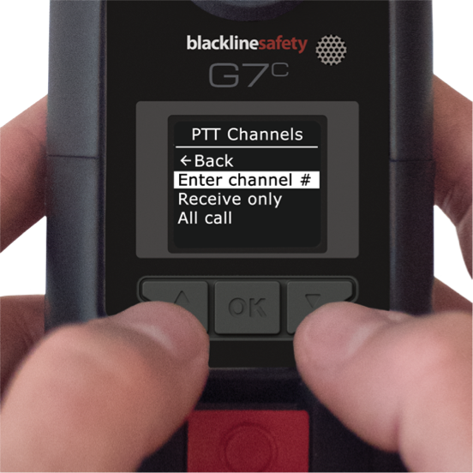
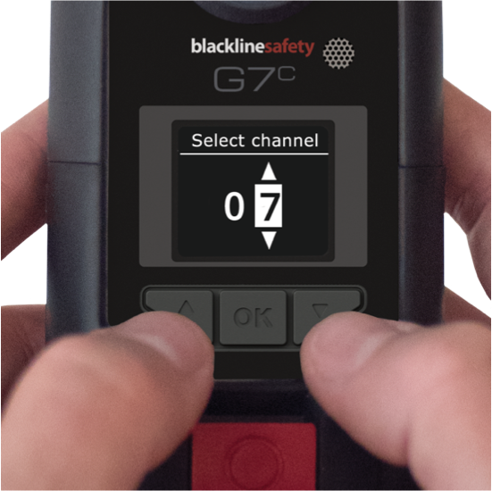
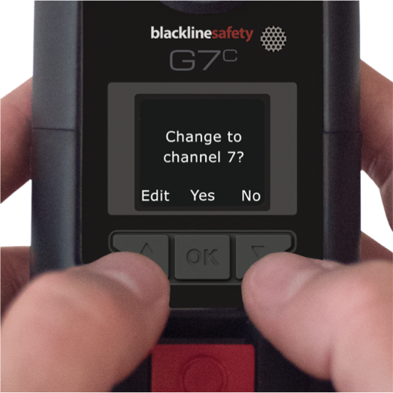
PUSH-TO-TALK - CHANNELS
Available Channels
Channels 0-99
Numbered channels for different groups of device users
Receive only
G7 only receives from all call and can’t transmit to any devices
All call
G7 Transmits to all PTT devices in
the organization and only receives from all call. This channel should only be used for safety supervisors.
CHANGING CHANNELS
1 2
3
Changing channels can be done from G7’s main or secondary menu.

Slide 19

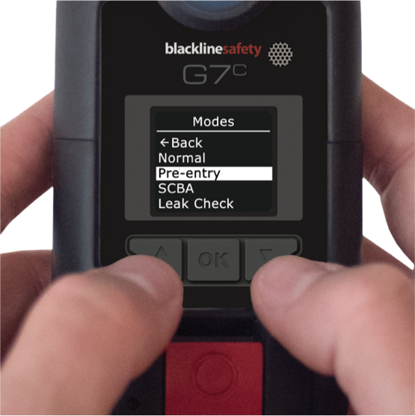
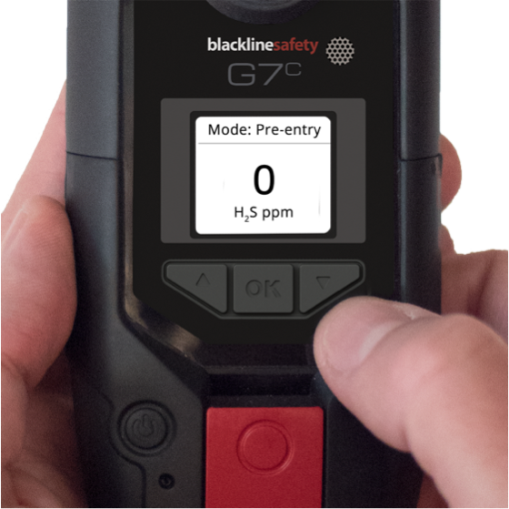
CONFIGURATION MODES
Available Modes
What is seen on your device is dependent on your configuration profile in Blackline Live
ENTERING A MODE
Normal mode
G7’s default for everyday operation
Pre entry
For checking an atmosphere before entering, with or without pump.
SCBA
For use with a supplied-air or self-contained breathing apparatus
Leak check
For checking an area for leaks, with or without pump.
High risk
For general high risk situations, like evacuations.
Pump run
Runs the pump continuously – such as for use in a hole-watch situation. A pump is required for this mode.
Entering a mode can be done from G7’s main or secondary menu.
When a mode is entered, G7’s screen will invert and the mode will be displayed in the top information banner.

Slide 20

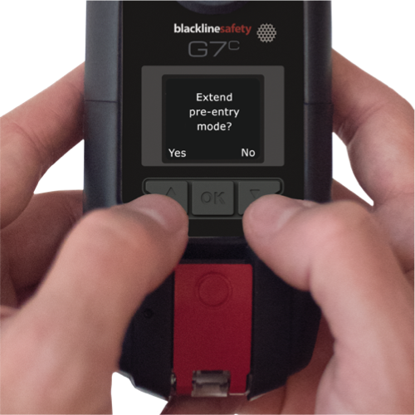
CONFIGURATION MODES
EXTENDING A MODE
When a mode timeout is reached, G7 will confirm that you’d like to stay in this mode.
What do I do?
Press the up arrow to extend the mode. Press the down arrow to exit the mode.
If you do not confirm that you would like to extend your mode within 30 seconds, G7 will return to normal mode, and if check-in is enabled, ask you to check in.
NOTE: High risk mode does not have a timeout, you must manually return to normal mode.

Slide 21
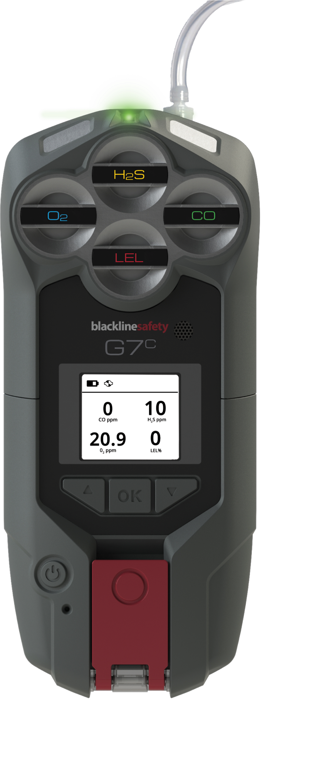
G7 MULTI-PUMP CARTRIDGE
Tubing
Quick-connect
Pump
TURNING PUMP ON
Attach a multi-gas pump cartridge to G7
Enter a pumped mode, such as pre-entry or leak check
Perform a block test, following the steps on G7’s screen.
Pump will start automatically
NOTE: if the block test fails, the device will not enter the mode and pump won’t start.
TURNING PUMP OFF
Enter a non-pumped mode, such as normal, SCBA or high-risk.

Slide 22
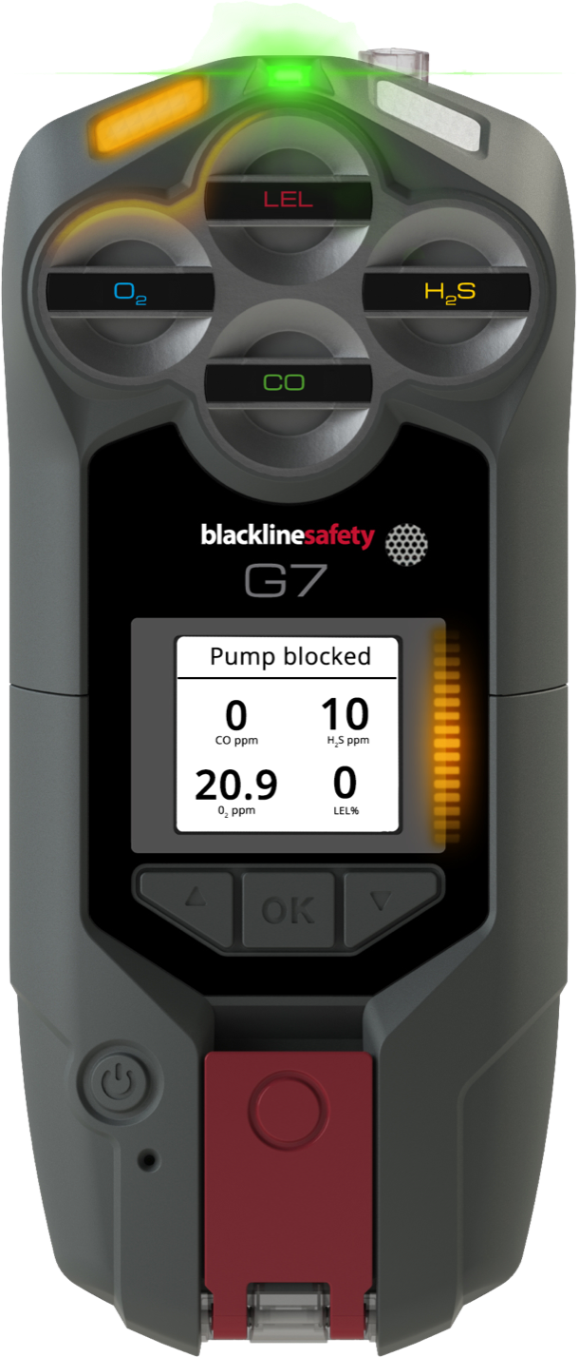
BLOCK TESTS
Block tests are performed to ensure your equipment is working properly before using pump to test the gas levels in an environment.
Blackline’s G7 multi-pump cartridge has two types of block tests:
AUTOMATIC BLOCK TEST
This is the block test that G7 runs through before entering a pumped mode.
The instructions for this block test appear on G7’s screen. If you pass the block test, G7 will enter the mode and pump will turn on.
If you fail the block test, G7 will return to normal mode.
MANUAL BLOCK TEST
This is the block test that you can perform anytime a pump is running.
To perform a manual block test:
Plug the end of your inlet
Wait for a yellow warning alarm
Unplug the end of your inlet
Wait for the alarm to stop
If the yellow warning alarm sounds when you plug, and stops when you release – your equipment is safe to use.
NOTE: G7 will go into yellow warning alarm when the pump is blocked during use.

Slide 23

PUMP MENU OPTIONS
When a G7 multi-pump cartridge is attached, a new secondary menu and main menu option appear.
Pump options
PUMP OPTIONS MENU
The pump options menu is available from G7’s main menu, under settings.
Back
Sample time ON Hose length
This is where you will set things such as:
Enabling/disabling sample timer
Hose length
SECONDARY MENU
The pump secondary menu is available by pressing the down arrow button from G7’s main screen.
Here you will see things such as:
Pump on Hose L: 10m 300 ml/min
Sample 70 sec.
If the pump is on/off
Hose length (set from the pump options menu)
Flow rate (in real time, maintained by G7)
Sample timer (if enabled from pump options)

Slide 24
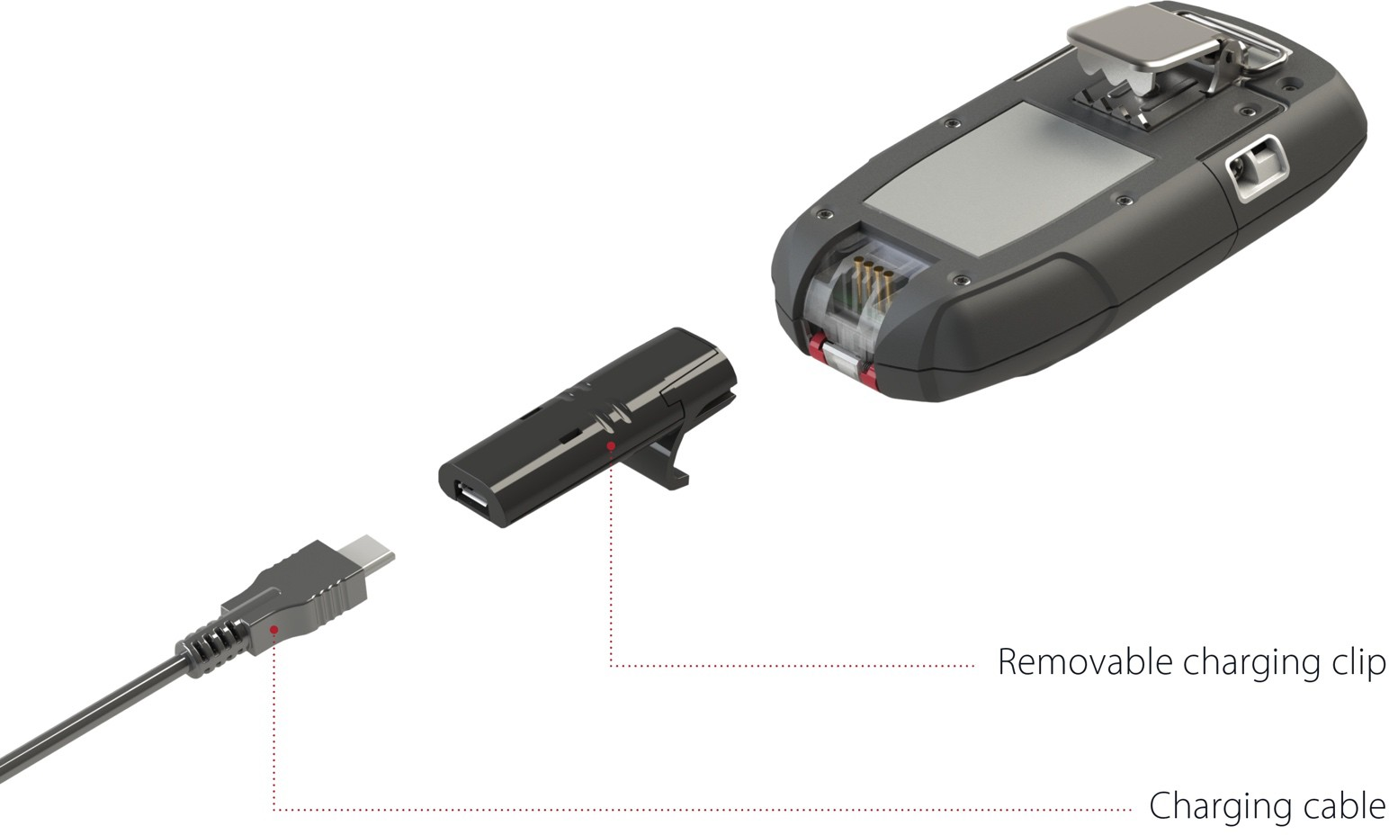
CHARGING
G7c has an 18 hour battery life Remember to charge after every shift!
What do I do?
Put the clip into the base of the G7, then plug in the micro USB.

Slide 25
QUESTIONS?

Slide 26

support.BlacklineSafety.com
SUPPORT
CUSTOMER CARE
For technical support, please contact our Customer Care team.
North America (24 hours)
Toll Free: 1-877-869-7212
support@blacklinesafety.com
International (24 hours)
+1-403-452-0327
support@blacklinesafety.com

